Slide 1
London
Lesson | Understanding local structures

Slide 2
Learning Objectives
Able to explain the differences between London boroughs and London constituencies
Understand what the responsibilities of London borough councils are
Understand how to find your local council and councillors online
Understand how councillors are elected
Identify and explore London-based issues with an action-based solution, using their knowledge of local political structures

Slide 3
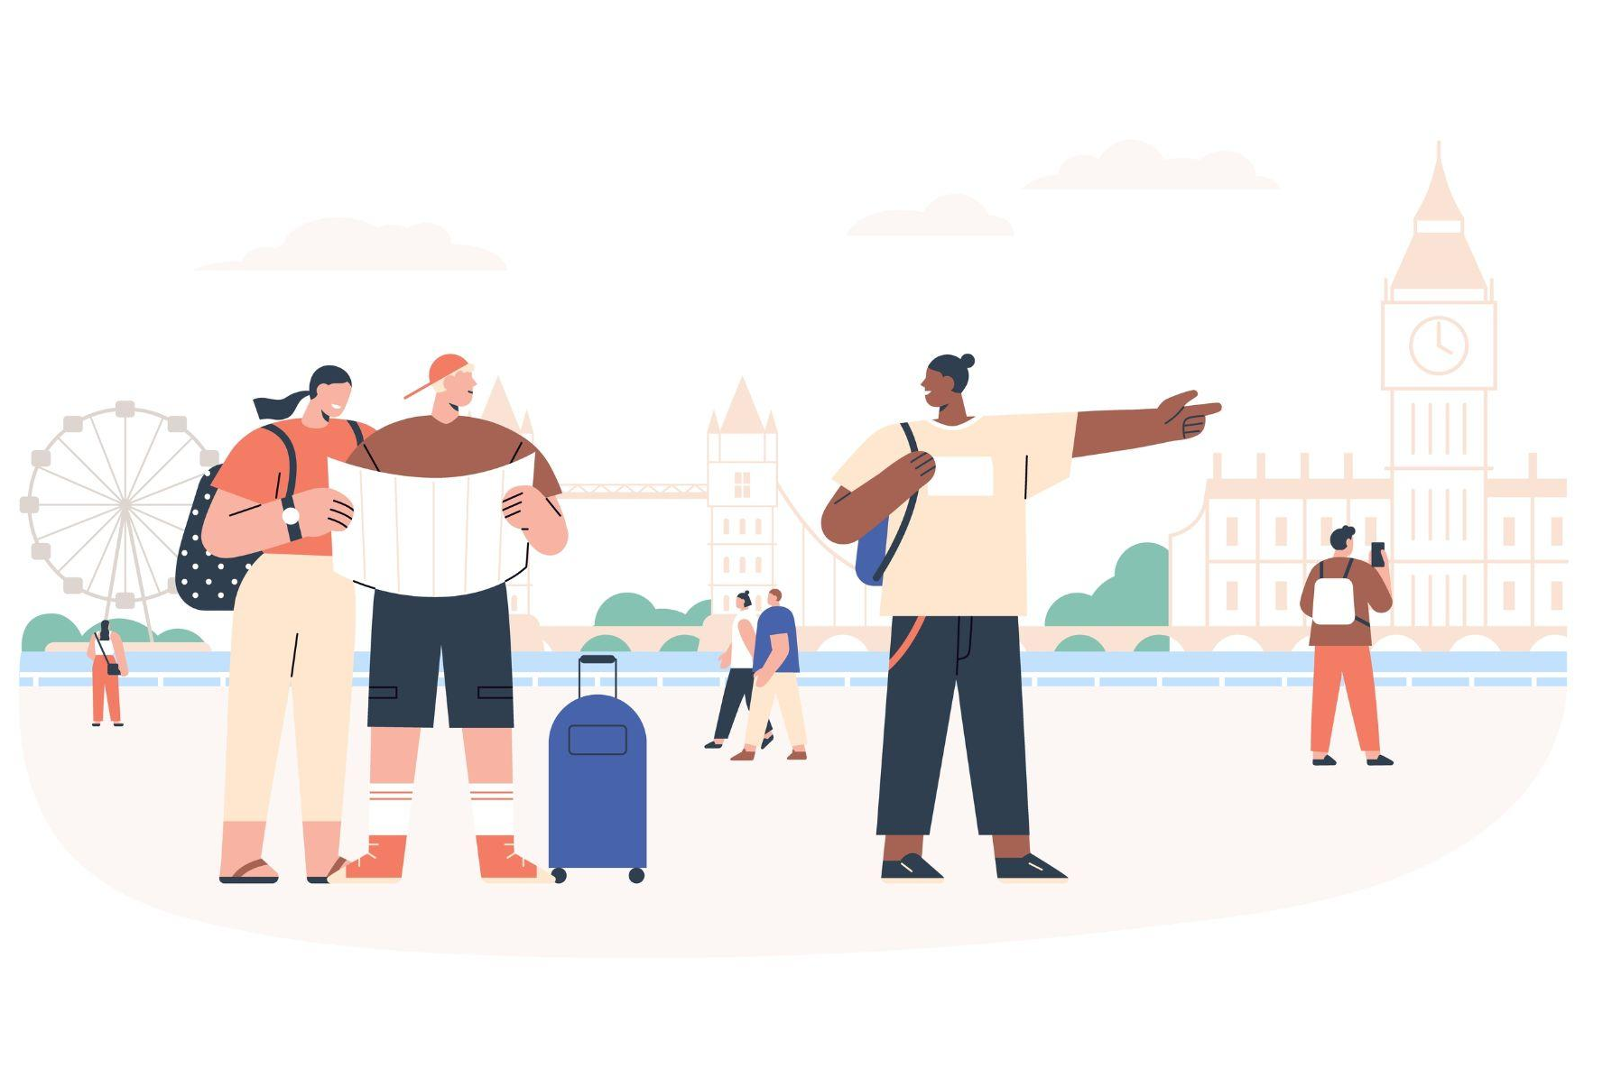
London has a population of around 9 million people!
This large amount of people are spread out over various areas and neighbourhoods of London. The needs of these areas can be very different.
For example, Westminster is a tourist hub and might require clear signposting accessible to visitors. Whereas Barnet, a suburb of North London, might require housing and green spaces for residents. By dividing the areas of London, borough councils can better manage and focus on the specific needs of the residents in those areas.

Slide 4
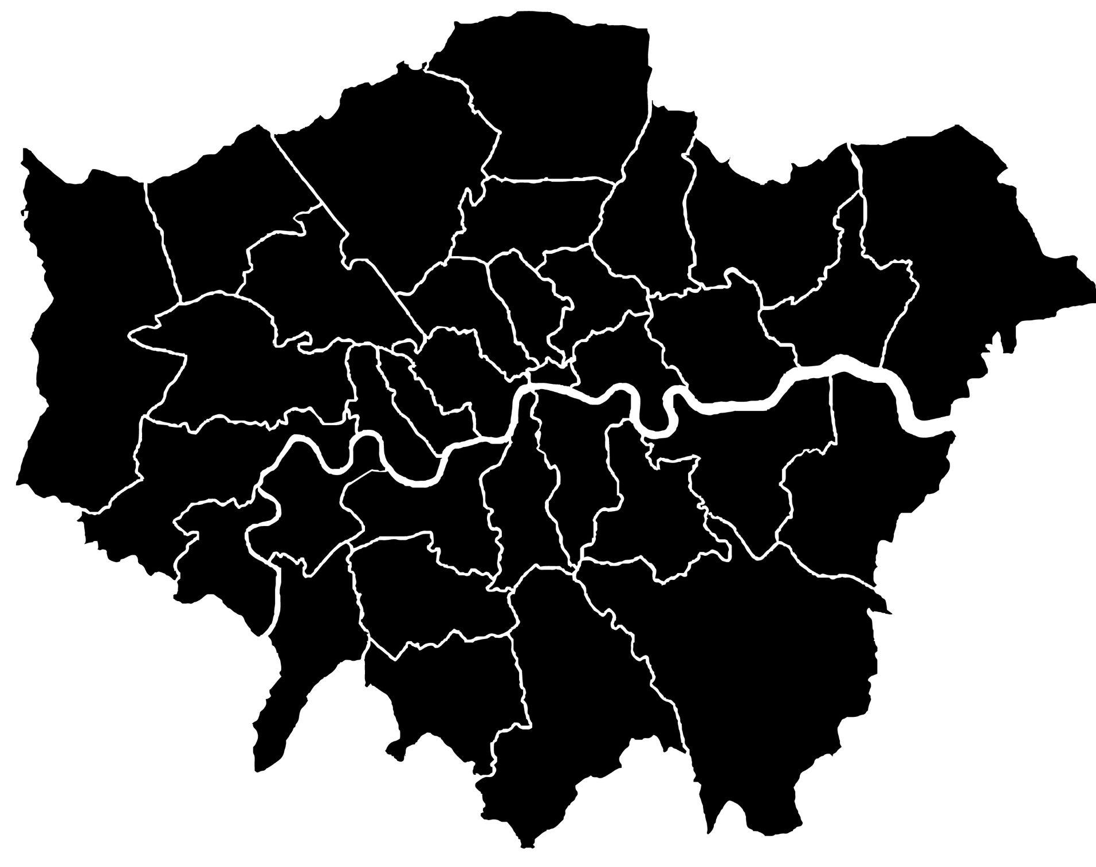
London boroughs
How many can you name?
Hint - there are 32!

Slide 5
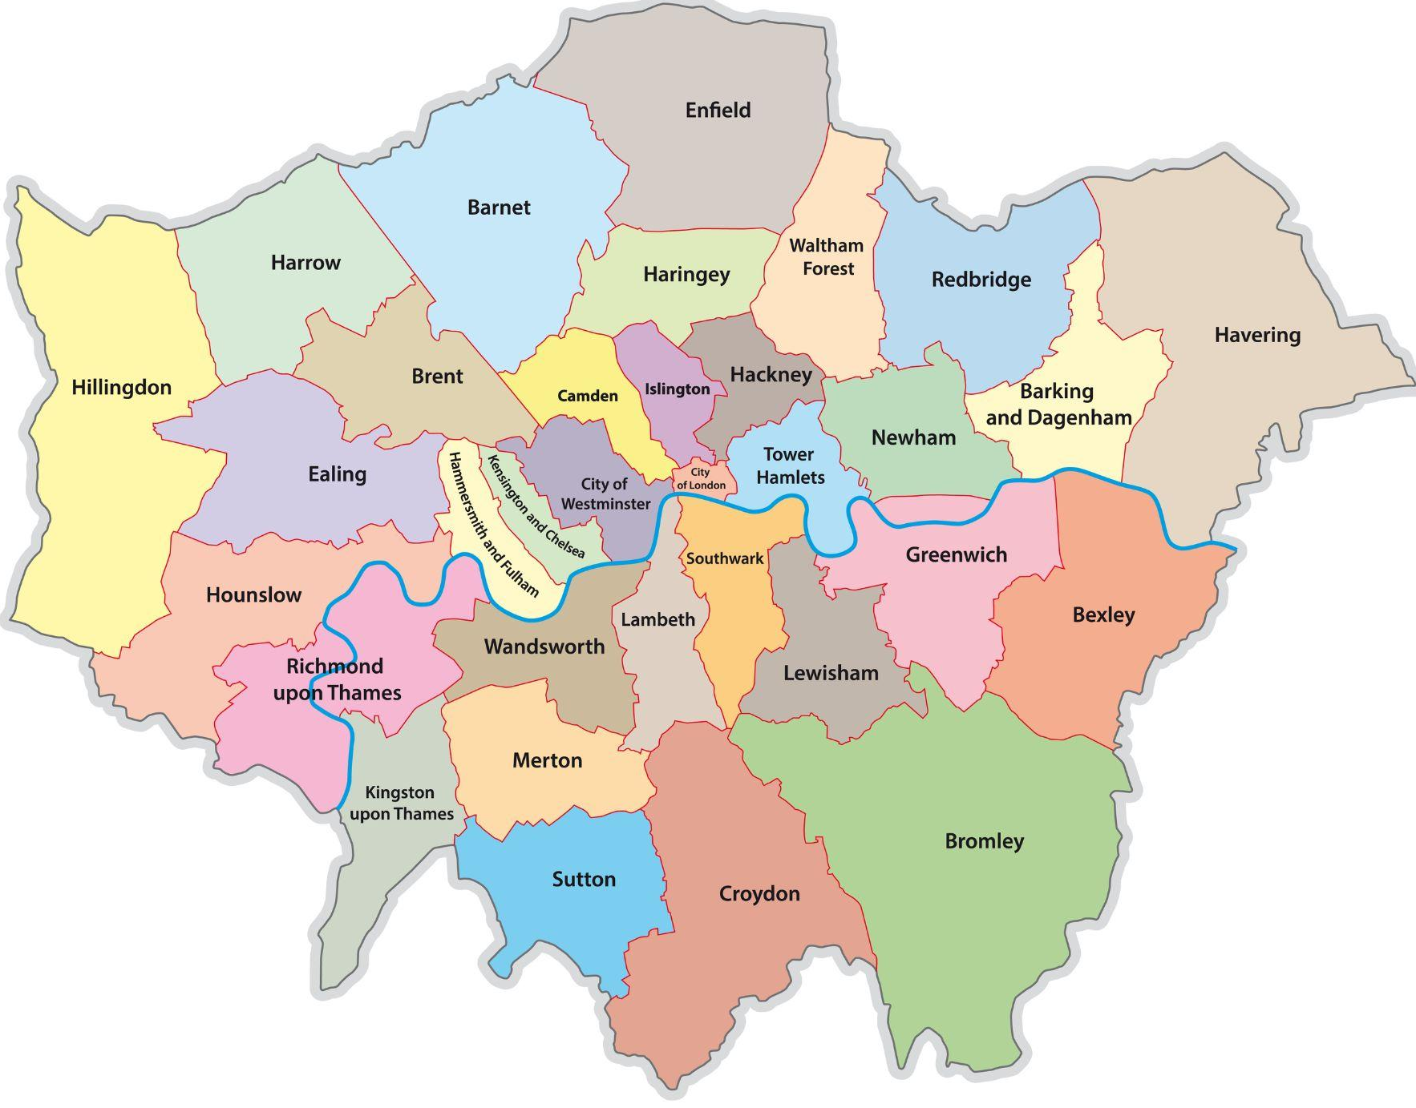
London boroughs
How many did you
get right?
The 32 London boroughs are run by
by individual borough councils.
FUN FACT
The City of London is not a
London borough, it’s a mini-city
in its own right, a ceremonial county
and the home of the financial district.
While part of Greater London, it has
its own police force and a Lord Mayor
of the City of London.

Slide 6
DISCUSS
What do you think your local council does?
We know that councils are responsible for London boroughs - but what does this really mean?
Discuss in groups of 3-4 classmates what you think councils do in the London boroughs. Make a list of
at least 3 things.

Slide 7
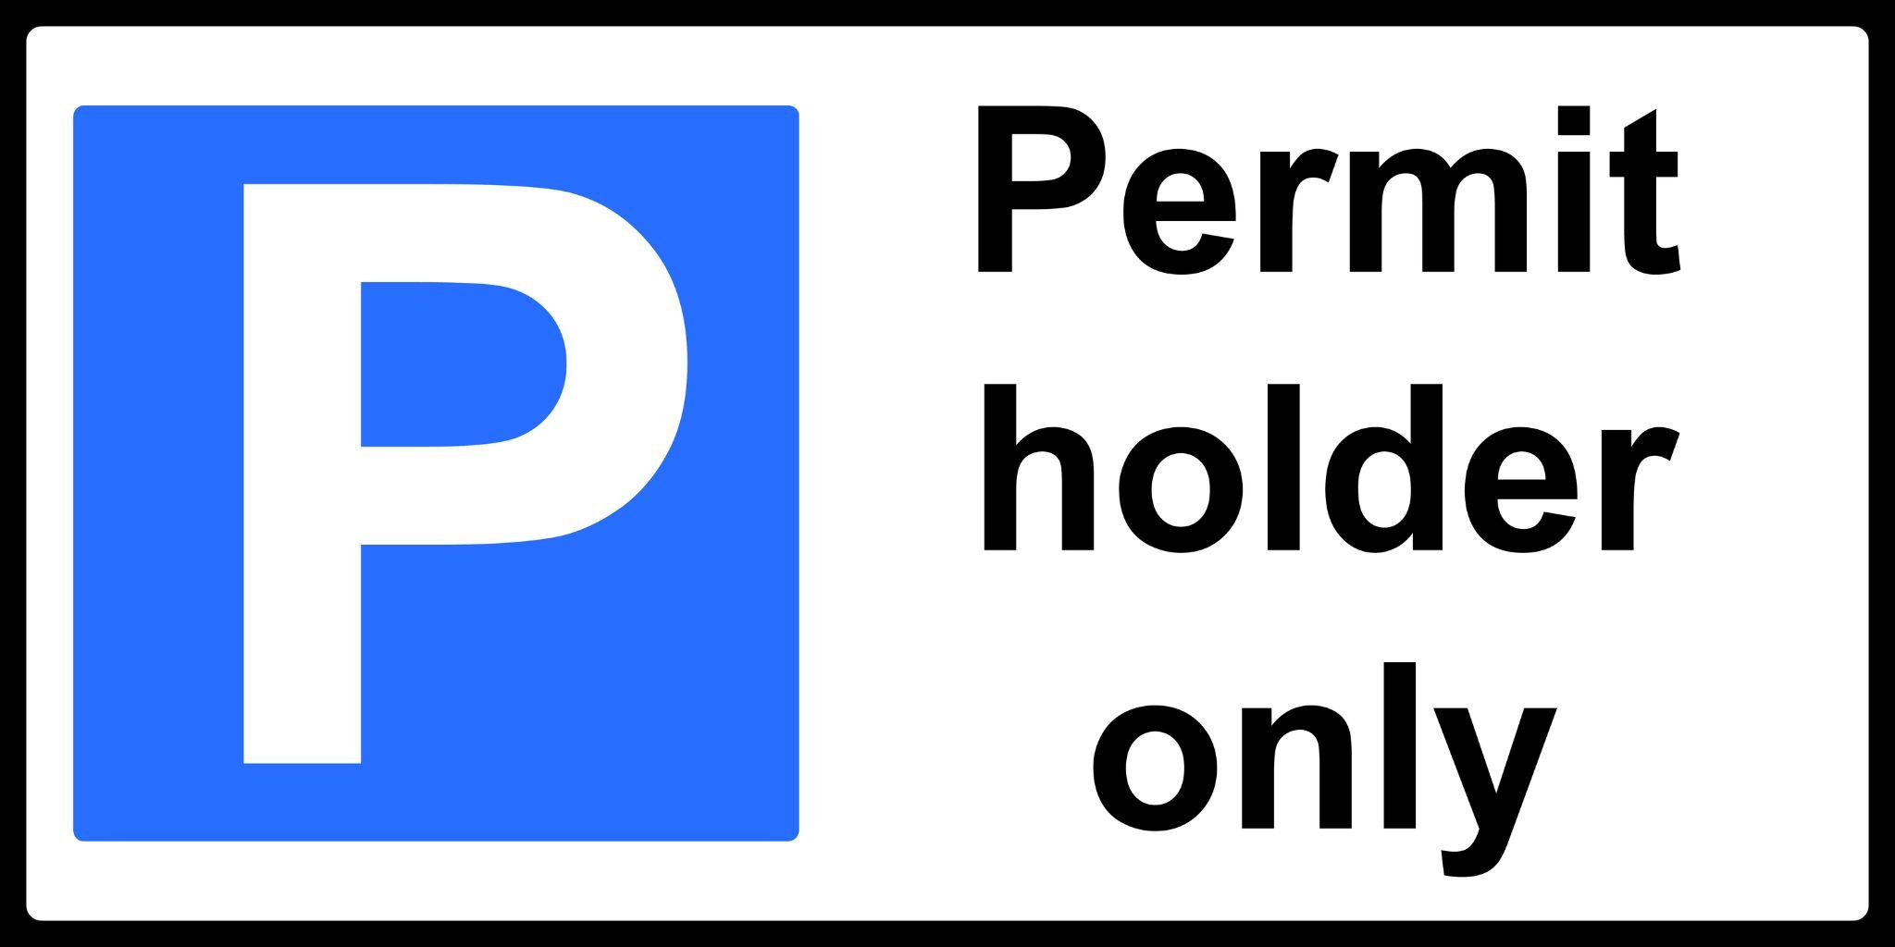
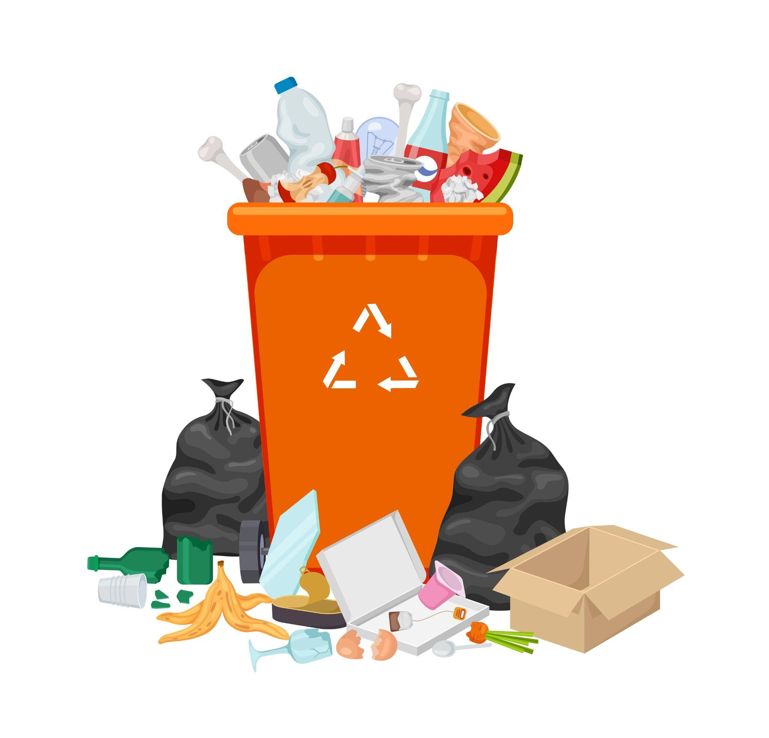
London borough councils provide the majority of day-to-day services for their local residents, including:
Rubbish collection
Recycling
Council Tax collections
Housing
Planning applications
Education
Social services
Arts and leisure services
Parking

Slide 8
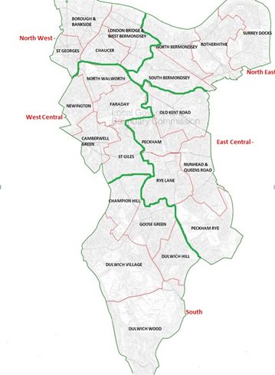
Council Elections
We now know the type of responsibilities that borough councils have, particularly when it comes to infrastructure and social issues affecting Londoners.
But who works in the Council and how do they get elected?
Councillors are elected every 4 years. Councillors can represent political parties, but also be independent. Boroughs are divided even further into small territorial units called ‘wards’. For example, Southwark borough council has 23 wards with 2-3 councillors elected in each ward.
Notes:
Source: https://www.southwark.gov.uk/council-and-democracy/voting-and-elections/southwark-council-elections-5-may-2022-information-for-voters#:~:text=Elections%20for%20the%20council%20are,63%20councillors%20across%2023%20wards.
Ward Map (Southwark Council): https://www.southwark.gov.uk/test/empowering-communities-programme

Slide 9
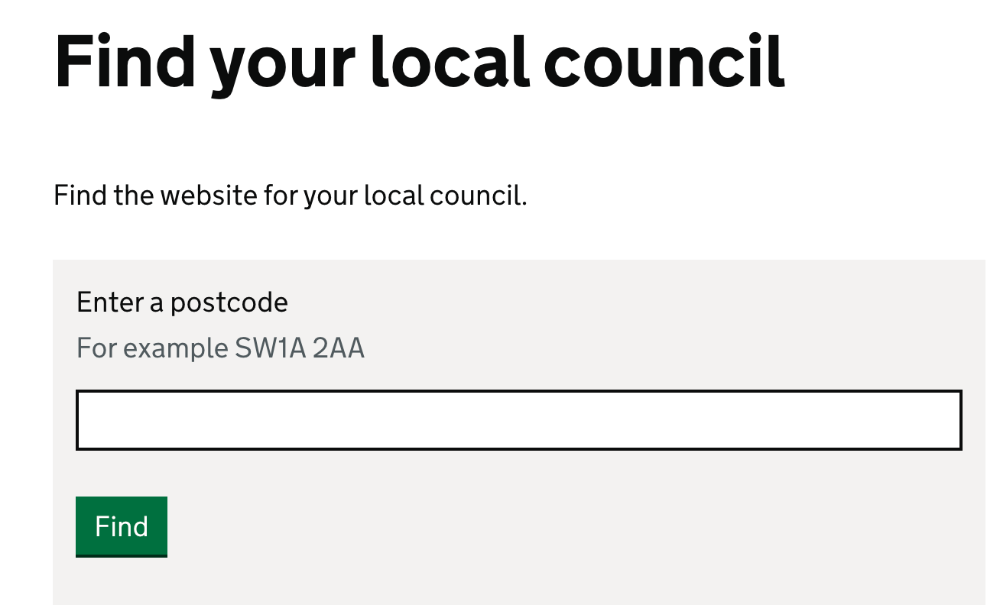
ACTIVITY
Do you know your local Council?
Go to: https://www.gov.uk/find-local-council

Slide 10
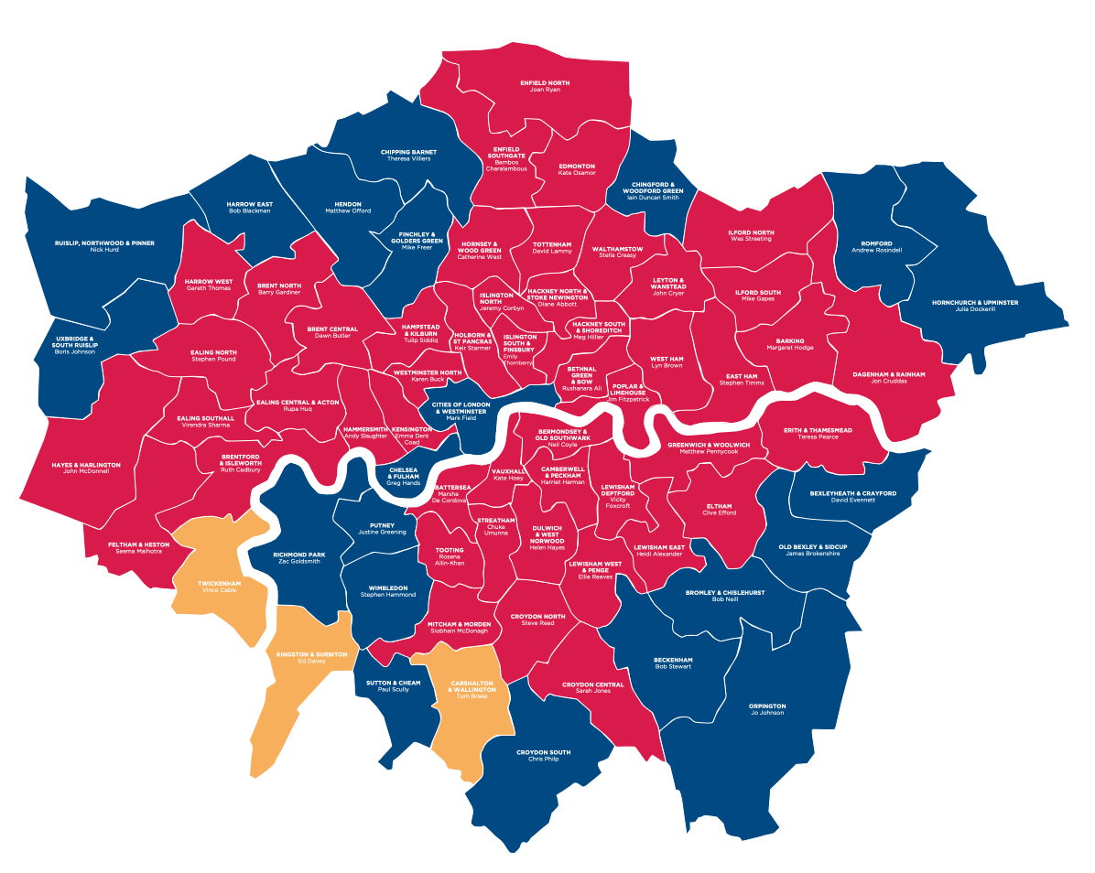
Boroughs vs Constituencies
London boroughs
32 boroughs
Each borough is divided into wards
Borough councils provide a range of services for residents, through elected councillors
London is also divided into constituencies. But what are they, and how are they different to boroughs?

Slide 11
More constituencies than boroughs
Constituencies are the areas represented by individual Members of Parliament (MPs). MPs are elected every 5 years in a general election.
This means that one London borough (with a population of between 150,000 and 400,000) is often cut into different constituencies (of roughly 70,000 people)! There are 73 constituencies in London!
Notes:
Source: https://www.ons.gov.uk/aboutus/transparencyandgovernance/freedomofinformationfoi/populationsofeachlondonboroughasofnovember2021

Slide 12
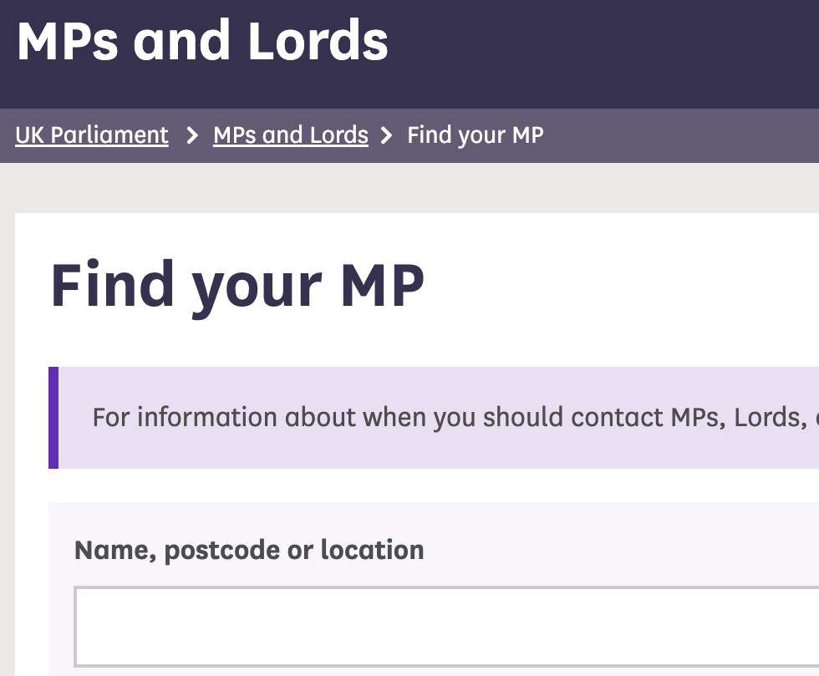
ACTIVITY
Do you know your local MP?
Go to: https://members.parliament.uk/FindYourMP

Slide 13
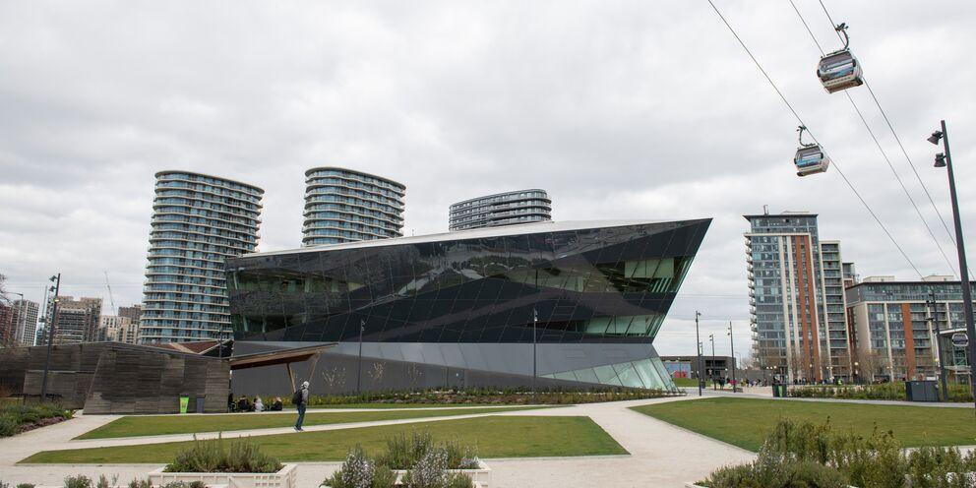
The Greater London Authority
Alongside borough councils, London City Hall (also known as the GLA) acts as the regional government of London by providing services such as police, fire, strategic planning, transport and social policies.
The GLA is made up of the Mayor of London – who oversees Transport for London (TfL), Mayor's Office for Policing and Crime (MOPAC, who monitors the Metropolitan Police), the London Fire Brigade, as well as policy on housing, the arts and health – and the London Assembly – made of Assembly Members voted by Londoners to scrutinise the Mayor.
The New City Hall by the Royal Docks

Slide 14
The Mayor of London
Who is the current Mayor of
London?
Notes:
Further info: https://www.london.gov.uk/about-us/mayor-london

Slide 15
DISCUSS
Can you think of any local issues affecting London?
London is a large urban city and therefore faces various challenges. Can you think of something in your area? Think about a variety of issues e.g. transport, environment, housing, etc.
Discuss in groups of 3-4 classmates what you think are some important issues affecting London.

Slide 16
DISCUSS AND WRITE
Pick an issue and create an action plan
In your group, pick one of the following issues:
Your bin has not been collected on time, more and more rubbish is ending up on the street.
There has been a rise in pickpocketing crime in your local area, but no one seems to be dealing with the problem.
No underground tube lines are working! You can’t get to school.
Which authority is responsible for the problem? Who would you contact for this? You have 5 minutes to create an action plan.

Slide 17
Video links
Do Londoners understand and vote in local elections?
This video by the BBC asks voters in London whether they will be voting in the 5 May 2022 London borough/ council elections.
View video
The next London-wide election will take place on 2 May 2024 and will be the election for the Mayor of London and the London Assembly.

Slide 18
Thank you
For more information contact the GLA Social Integration Team
elisabeth.pop@london.gov.uk
london.gov.uk

