Slide 1
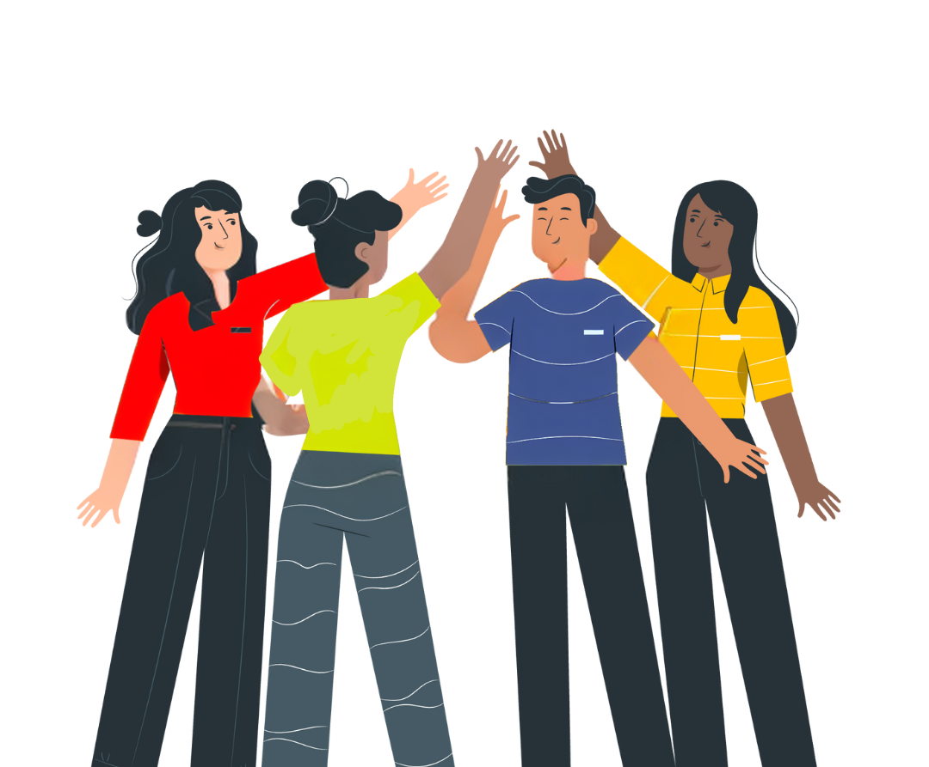
No Vote, No Voice!
Democracy doesn’t end at the ballot box, it starts there.
Funded by the Greater London Authority, City Hall, Kamal Churchie Way, London, E16 1ZE

Slide 2
In this session we will explore the following questions:
Why is it important to know your civic and democratic rights?
What is the difference between civic and democratic rights and how can you exercise those rights?
How can you have your voice heard in the voting system (if eligible)?
How can you continue to have your voice heard by your representatives beyond an election?

Slide 3
Why is it important to know your civic and democratic rights?

Slide 4
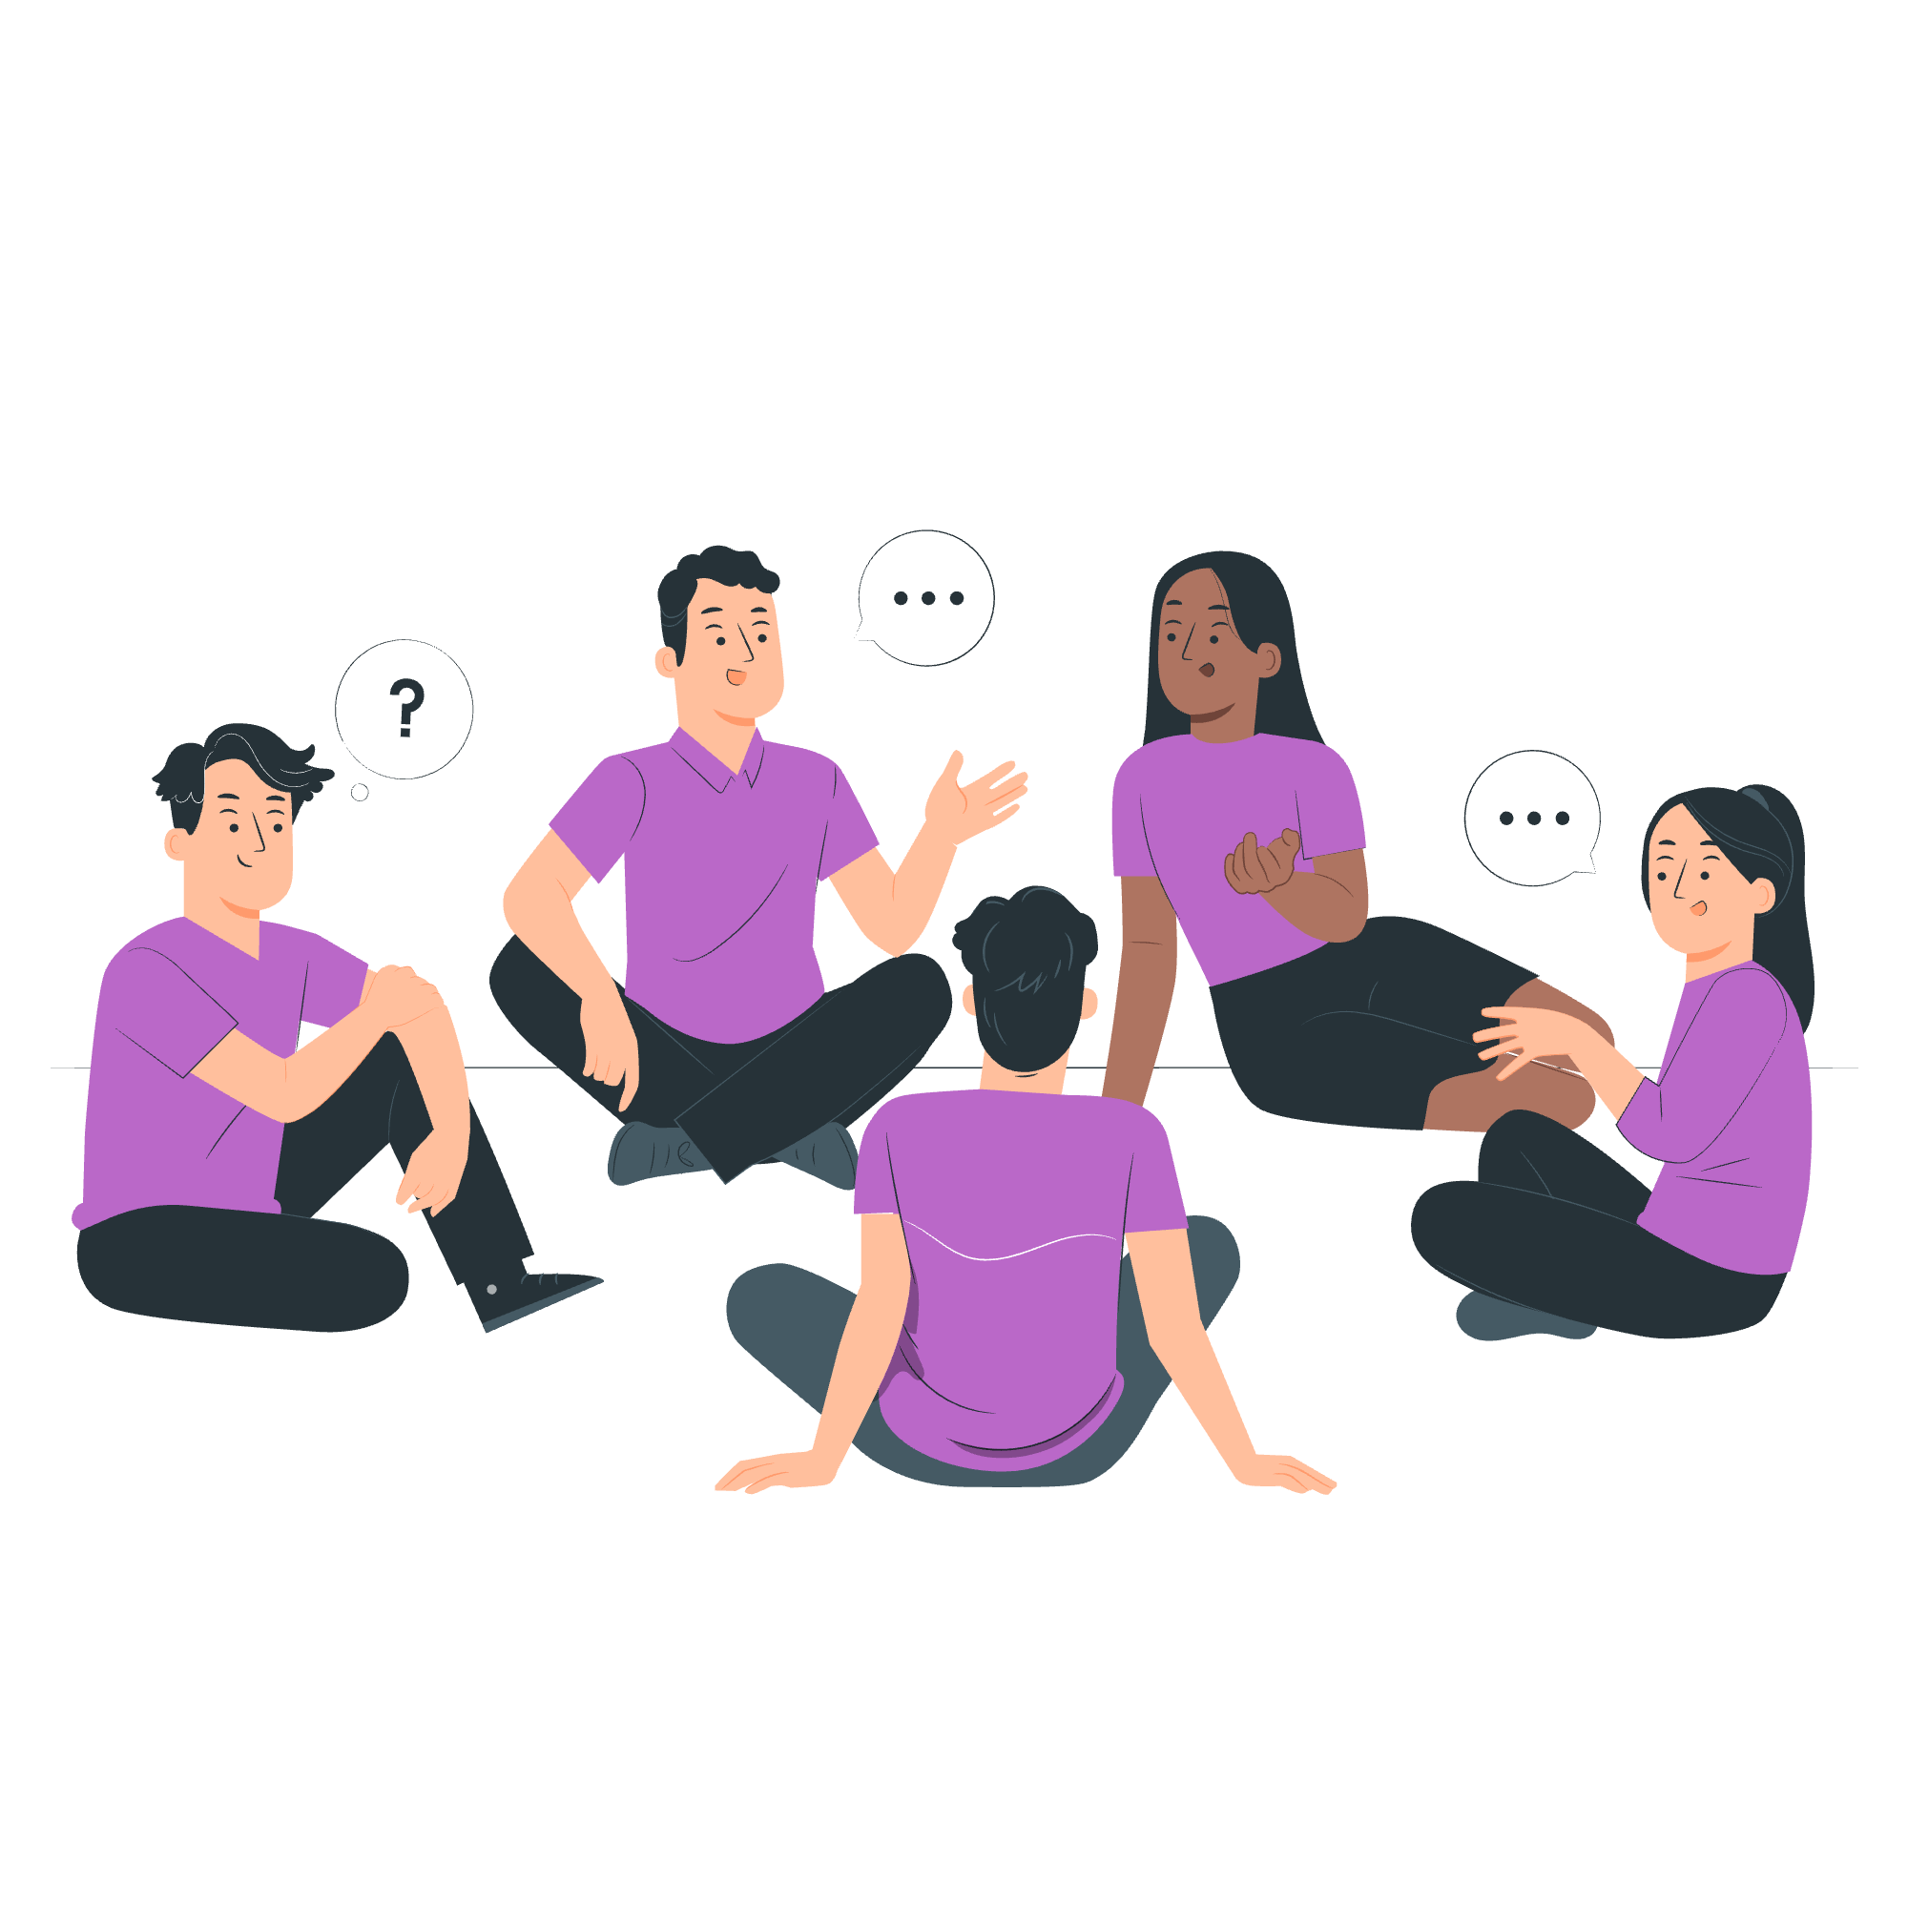
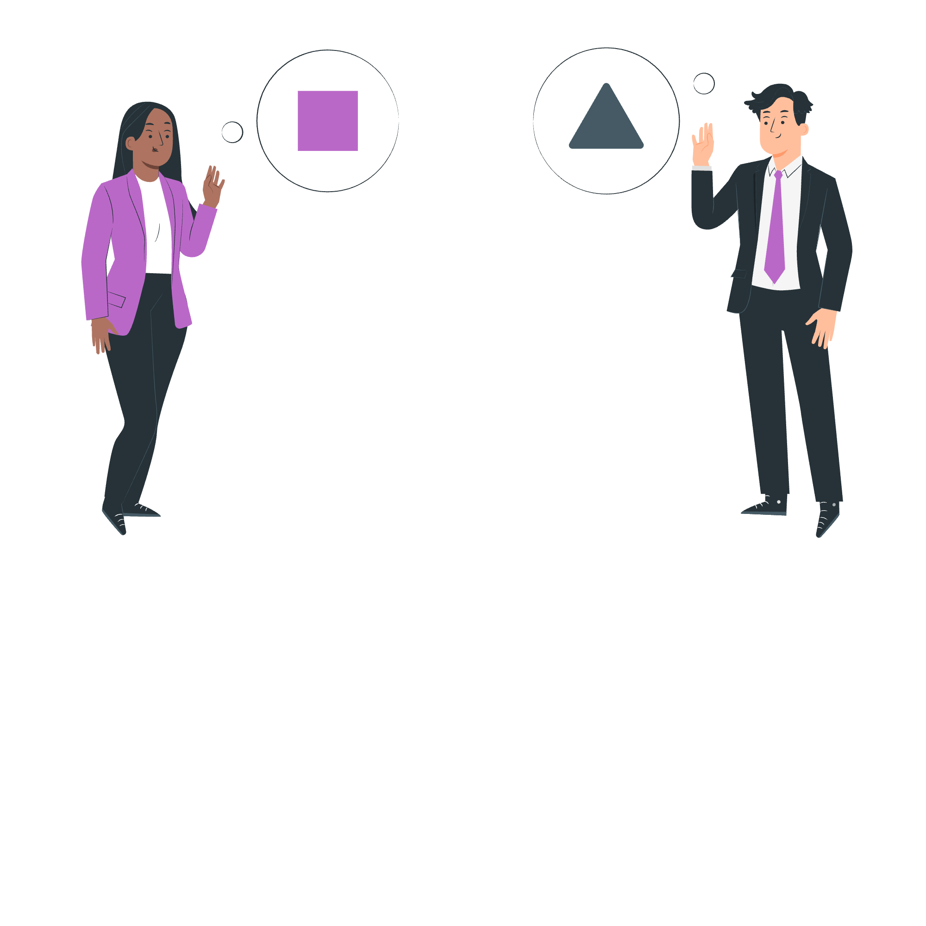
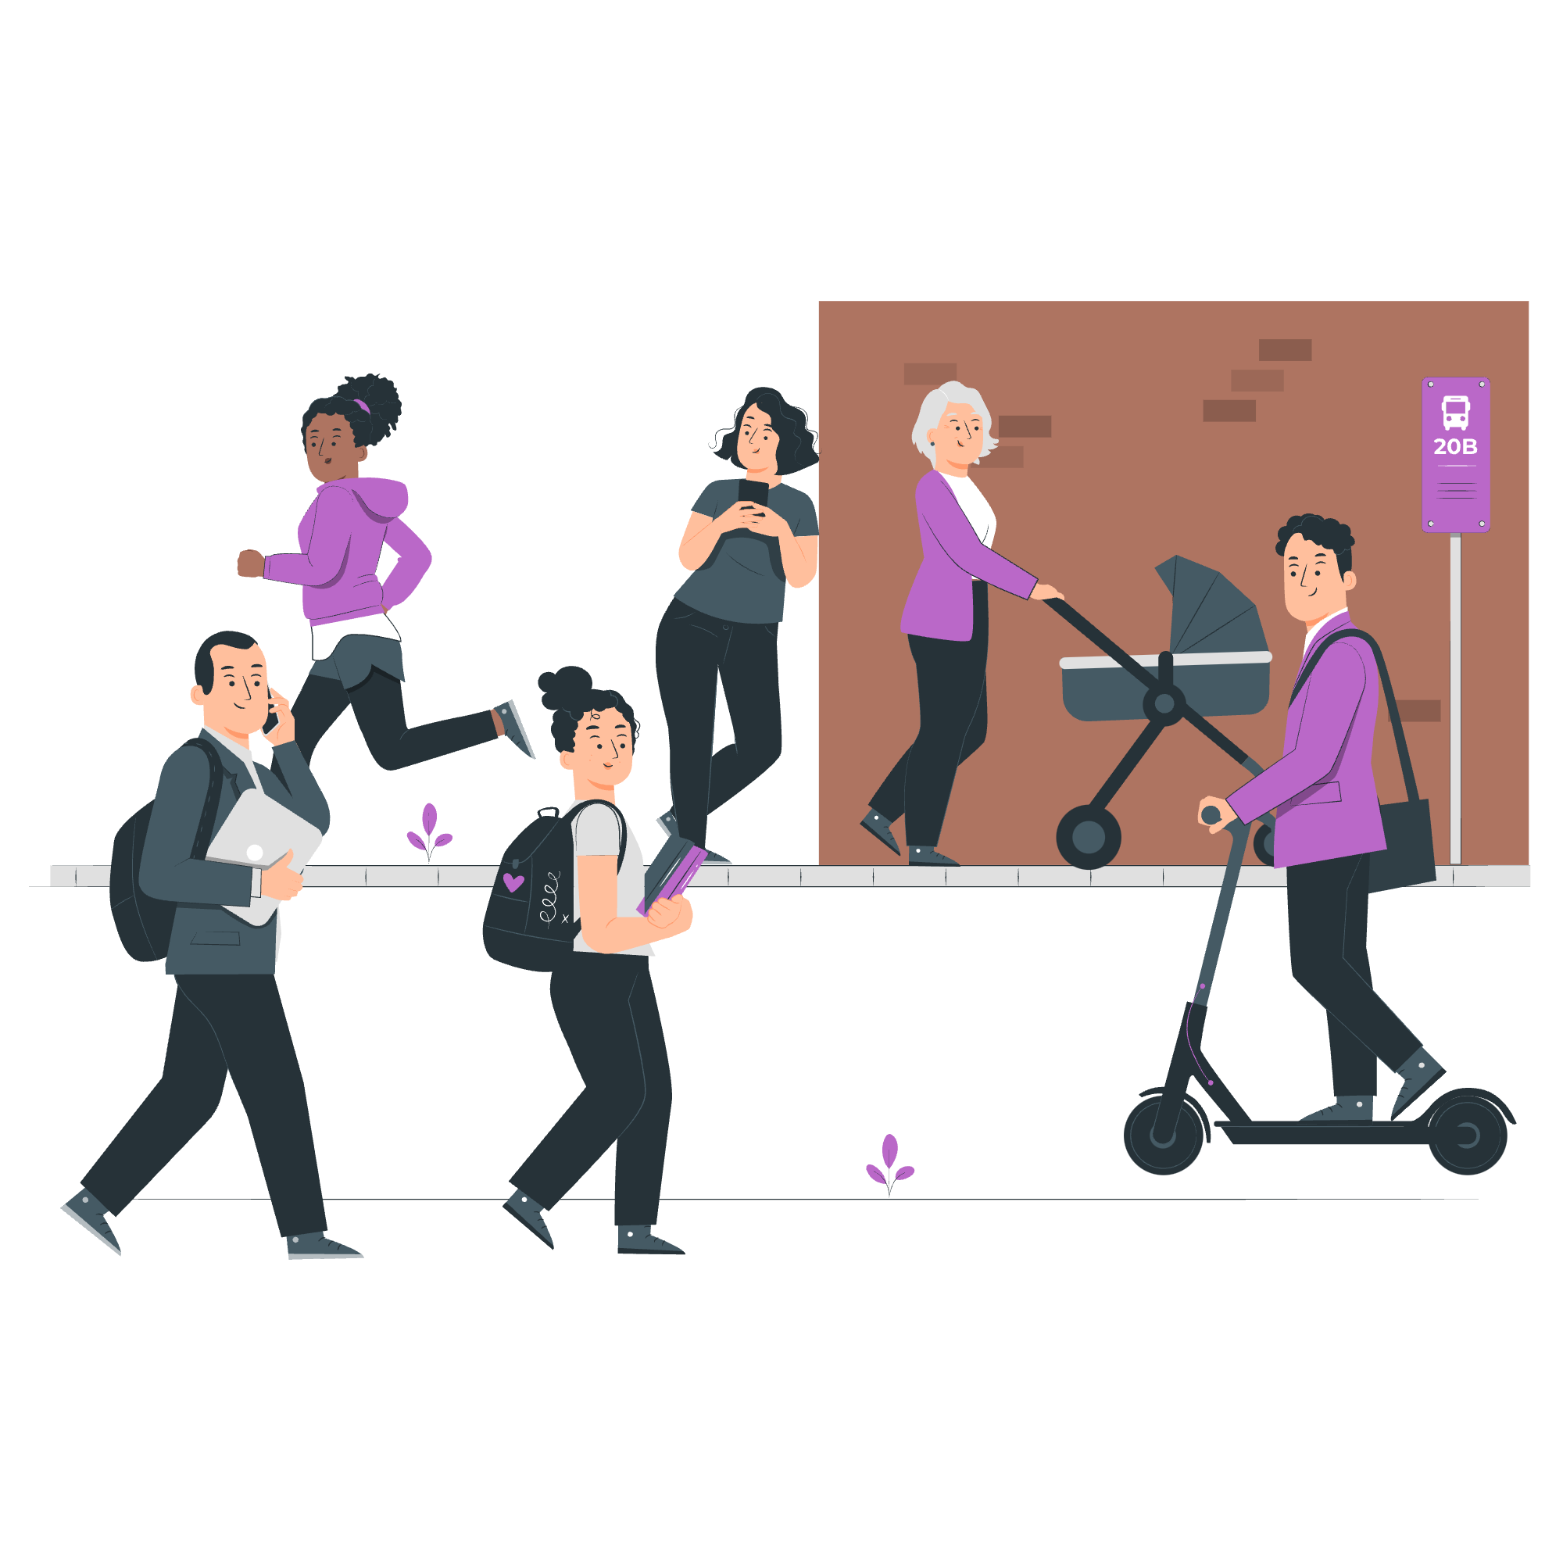
To have a voice
To build stronger communities
To engage with your representatives
Why participate in democracy and civic life?
To gain knowledge and skills
To support equality and justice
To make a difference on issues they care about

Slide 5
What is the difference between civic and democratic rights and
how can you exercise these rights?
Civic Rights include:
The ability to start or sign petitions
Taking part in peaceful, legal protest
Being involved in community organising
Volunteering
Democratic Rights include:
Registering to vote, if eligible
Voting in elections, such as local/ borough council, Mayor of London and London Assembly, general/ parliamentary elections
Taking part in citizens’ assemblies, or other forms of deliberative or participatory democracy
Standing for elected office

Slide 6
Civic rights:
Start or sign petitions
Official petitions appear on https://petition.parliament.uk/. If a petition reaches 10,000 signatures, the government will respond.
Take part in peaceful, legal protest
Everyone has the right to protest in a peaceful and legal way. If you’re planning a protest, you may need to notify the police in advance.
Community organising and volunteering
Community organising brings local people together to create the change they want to see. Volunteering helps you upskill, meet new people, and make a difference.
Funded by the Greater London Authority, City Hall, Kamal Churchie Way, London, E16 1ZE

Slide 7
Democratic rights:
Register to vote and vote, if eligible
If you are eligible to vote, you can register at 16, and vote at 18. Your vote will help choose the candidate(s) that will represent you.
Stand for elected office
If eligible, at 18 you can also become a candidate for Mayor of London, London Assembly member, Member of Parliament (MP), local councillor.
Take part in Citizens’ Assemblies
A Citizens' Assembly is a randomly selected group of people who learn about and discuss specific issues, then make recommendations on related actions. You do not necessarily need to be eligible to vote to take part.

Slide 8
Who can you vote for?
There are three types of election in London:

Slide 9
Which London residents are eligible to vote in these elections?
 | Mayor of London and London Assembly | General / parliamentary | Local / borough
Must be at least 18 years of age | ✅ | ✅ | ✅
British or Irish citizens | ✅ | ✅ | ✅
Qualifying Commonwealth citizens | ✅ | ✅ | ✅
Qualifying EU citizens or EU citizens with retained rights | ✅ | ❌ | ✅
For further information on eligibility, head to electoralcommission.org.uk

Slide 10
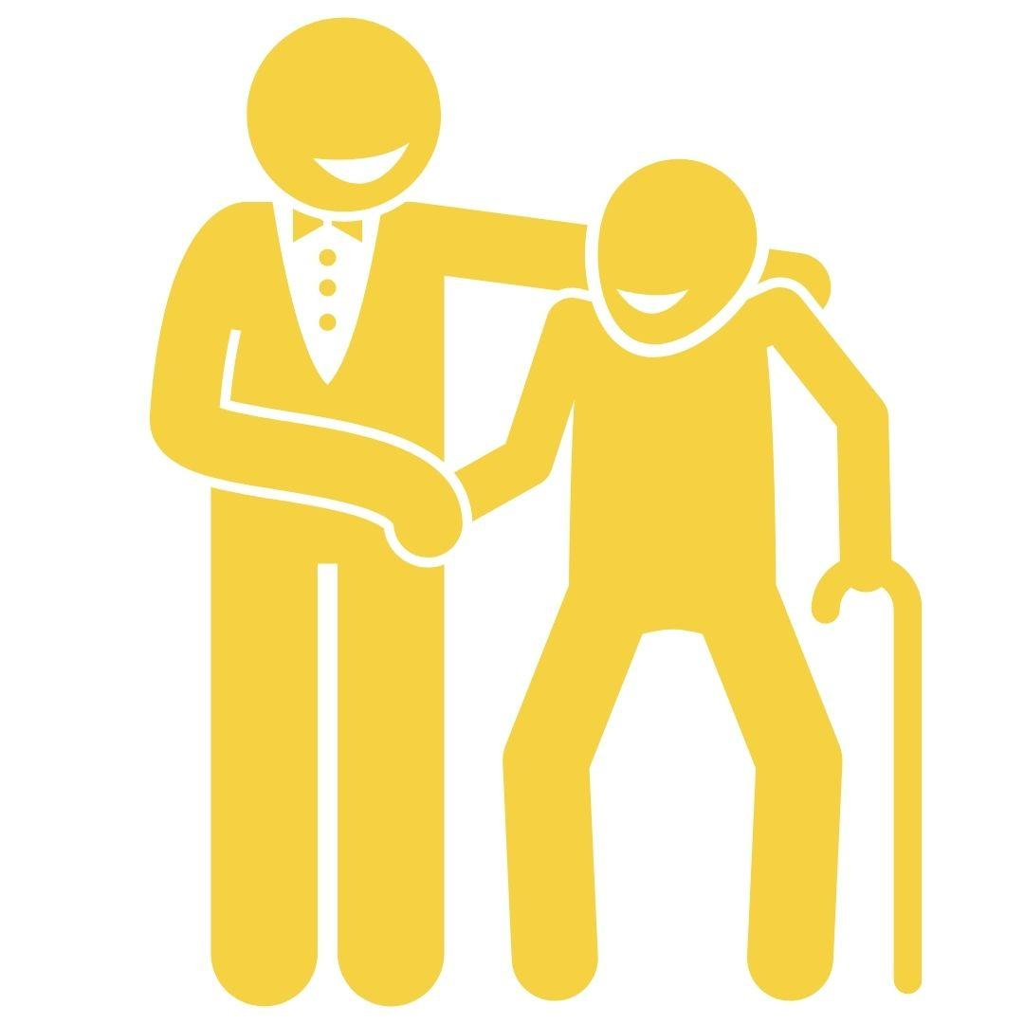
How can you have your voice heard in the voting system?
1
To register to vote, head to gov.uk/register-to-vote
2
You can vote in person, by post or by proxy
3
You need an accepted form of ID to vote in person
UK, Channel Islands or EEA driving licence
UK, commonwealth
or EEA passport
Blue Badge scheme card
These include, but are not limited to:
Notes:
Please note that a young person’s Oyster or student ID are NOT accepted forms of ID to vote in person.

Slide 11
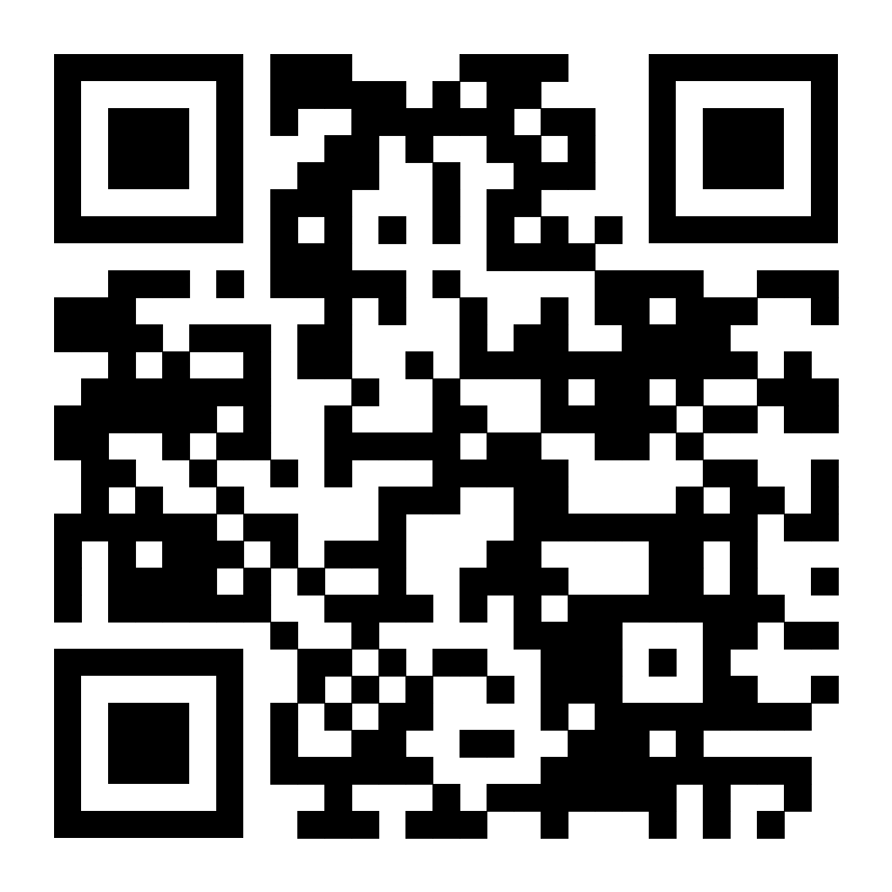
How can I register to vote?
Make sure you meet the eligibility criteria
Make sure you have the following information:
Your name
Your date of birth
Your address
Go to gov.uk/register-to-vote or scan this QR code
Fill in the form: don't worry if you do not have a National Insurance number.

Slide 12
What are the different types of electoral register?
The Electoral Register
This lists the names and addresses of everyone who is registered to vote in local/ borough council or parliamentary/ general elections. It is used for electoral purposes and for jury selection.
The Open Register
This is an extract of the electoral register, but it is not used for elections. Any person, company or organisation can buy this information.
As an elector, you can opt out of the open register.
Anonymous Register
If your name and address being on the electoral register could affect your safety, or the safety or someone in your household, you can register anonymously. You will still be able to vote, but your name and address will not be on the electoral register.

Slide 13
I am now registered, but what are the different ways that I can vote?
In Person:
You will be sent a poll card to your address. The poll card will tell you where your local polling station is, and the date and time you can vote. Bring an accepted form of photo ID.
By Proxy:
Getting someone that you trust to cast your vote on your behalf. You can do this if you are unable to get to the polling station yourself.
By Post:
You will receive your ballot papers and postal voting statement before polling day. You will then make your choice and send in back in the post.

Slide 14
What if I change my personal details, don’t know my National Insurance number or don’t have a fixed address?
If you move address, change your name or nationality (for e.g. gain British citizenship), you will have to re-register.
Don't worry if you do not know your National Insurance number. When asked during the registration process, leave your email or other contact details, and the Electoral Registration Office in your local authority will get in touch to support.
Don’t worry if you don’t have a fixed or permanent address, you can still register.

Slide 15
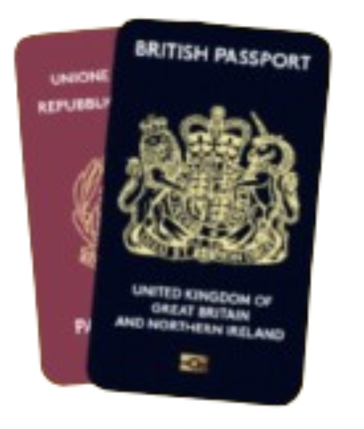
What are some accepted forms of photo ID to vote in person?
UK, Channel Islands or EEA driving licence
National identity card issued by an EEA state
Biometric immigration document
PASS card issued by the National Proof of Age Standards Scheme bearing the PASS hologram
Blue Badge scheme card
60+ Oyster photocard or a Freedom Pass
UK, commonwealth
or EEA passport

Slide 16
What if I don’t have an accepted form of photo ID?
You can apply for a free Voter Authority Certificate if:
You do not have an accepted form of photo ID
You no longer look like the photo on your ID
The name on your photo ID is different to the
name on the electoral register

Slide 17
Why should you engage with the Greater London Authority?
Mayor of London
The Mayor of London is elected to set city-wide/ regional priorities:
• Transport for London
• Mayor’s Office for Policing and Crime
• London Fire Brigade
• Housing
• Environment
• Culture and arts.
The Greater London Authority (GLA) is made up of
London Assembly
The London Assembly holds the Mayor to account.
• It is elected by Londoners, at the same time as the Mayor.
• It is composed of 25 Assembly Members: 14 represent geographic areas (2 or 3 London boroughs) and 11 work pan-London.

Slide 18
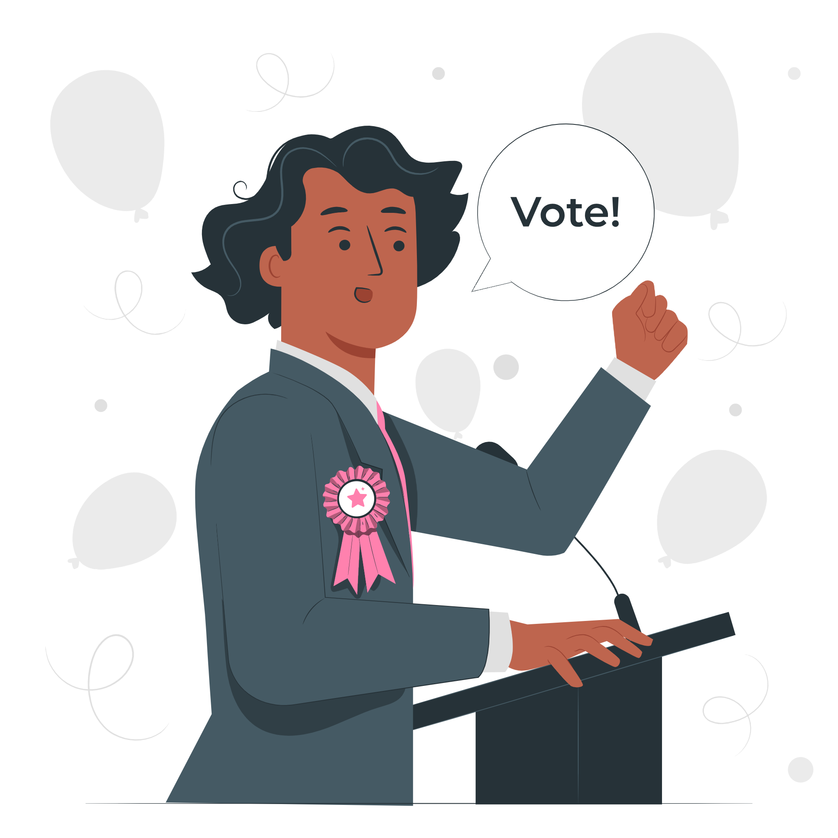
Why should you engage with your Member of Parliament (MP) or local councillor?
Member of Parliament (MP)
In a general election, you vote for the MP that you want to represent your constituency.
They can influence the decision-making in Parliament on:
The economy
Education
Healthcare
Housing
Environment
Councillor
Work in the borough council (the local authority), which oversees this and more:
Council tax collections
Rubbish and recycling
Arts and leisure services
Housing (borough)
Environment (borough)
Health and wellbeing

Slide 19
How can you continue to have your voice heard by representatives beyond an election?
Engage with them by:
Writing to them – the emails and addresses are publicly available
Talking to them - MPs often have surgery hours where you can meet them and discuss issues that matter to you
Following their record – the voting records of your representatives are publicly available
Find out who represents you:
MP - members.parliament.uk
Mayor of London - london.gov.uk
London Assembly - london.gov.uk
Local councillor - gov.uk
Find your representatives’ contact details: www.writetothem.com
Follow what is being said & voted for in parliament:
hansard.parliament.uk
Notes:
Important to note that whether you are eligible to vote or not, you can participate in these ways of engagement.

Slide 20
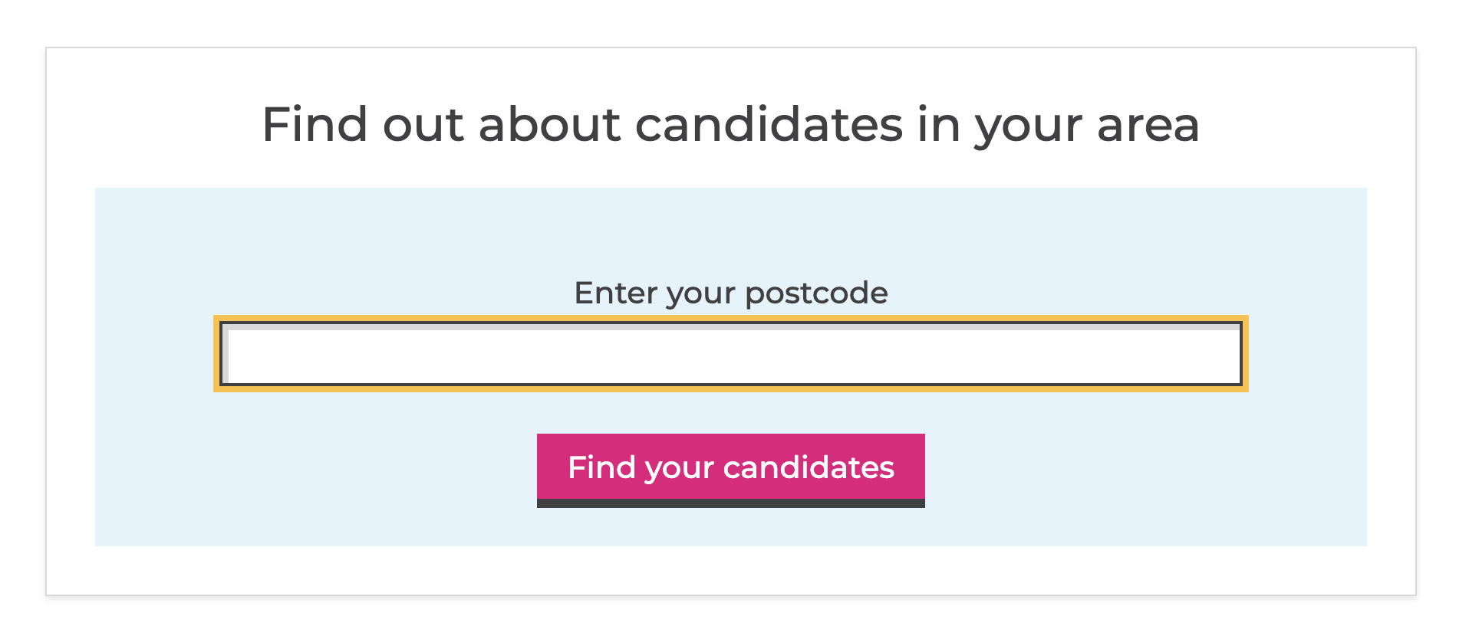
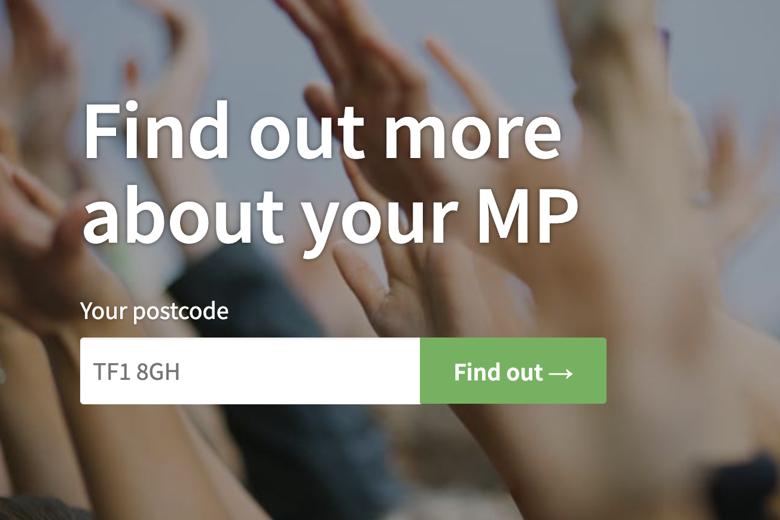
Where can I find more information?
GLA Democracy Hub
Provides resources and a comprehensive FAQ in both Easy Read and community languages. You can also use a WhatsApp chatbot (+44 7908820136) to answer questions you may have!
Who Can I Vote For?
Helps to find the candidates in your area, at various elections, based on publicly - available info.
TheyWorkForYou
Tells you the voting record on policy issues and public statements from Members of Parliaments and others.

Slide 21
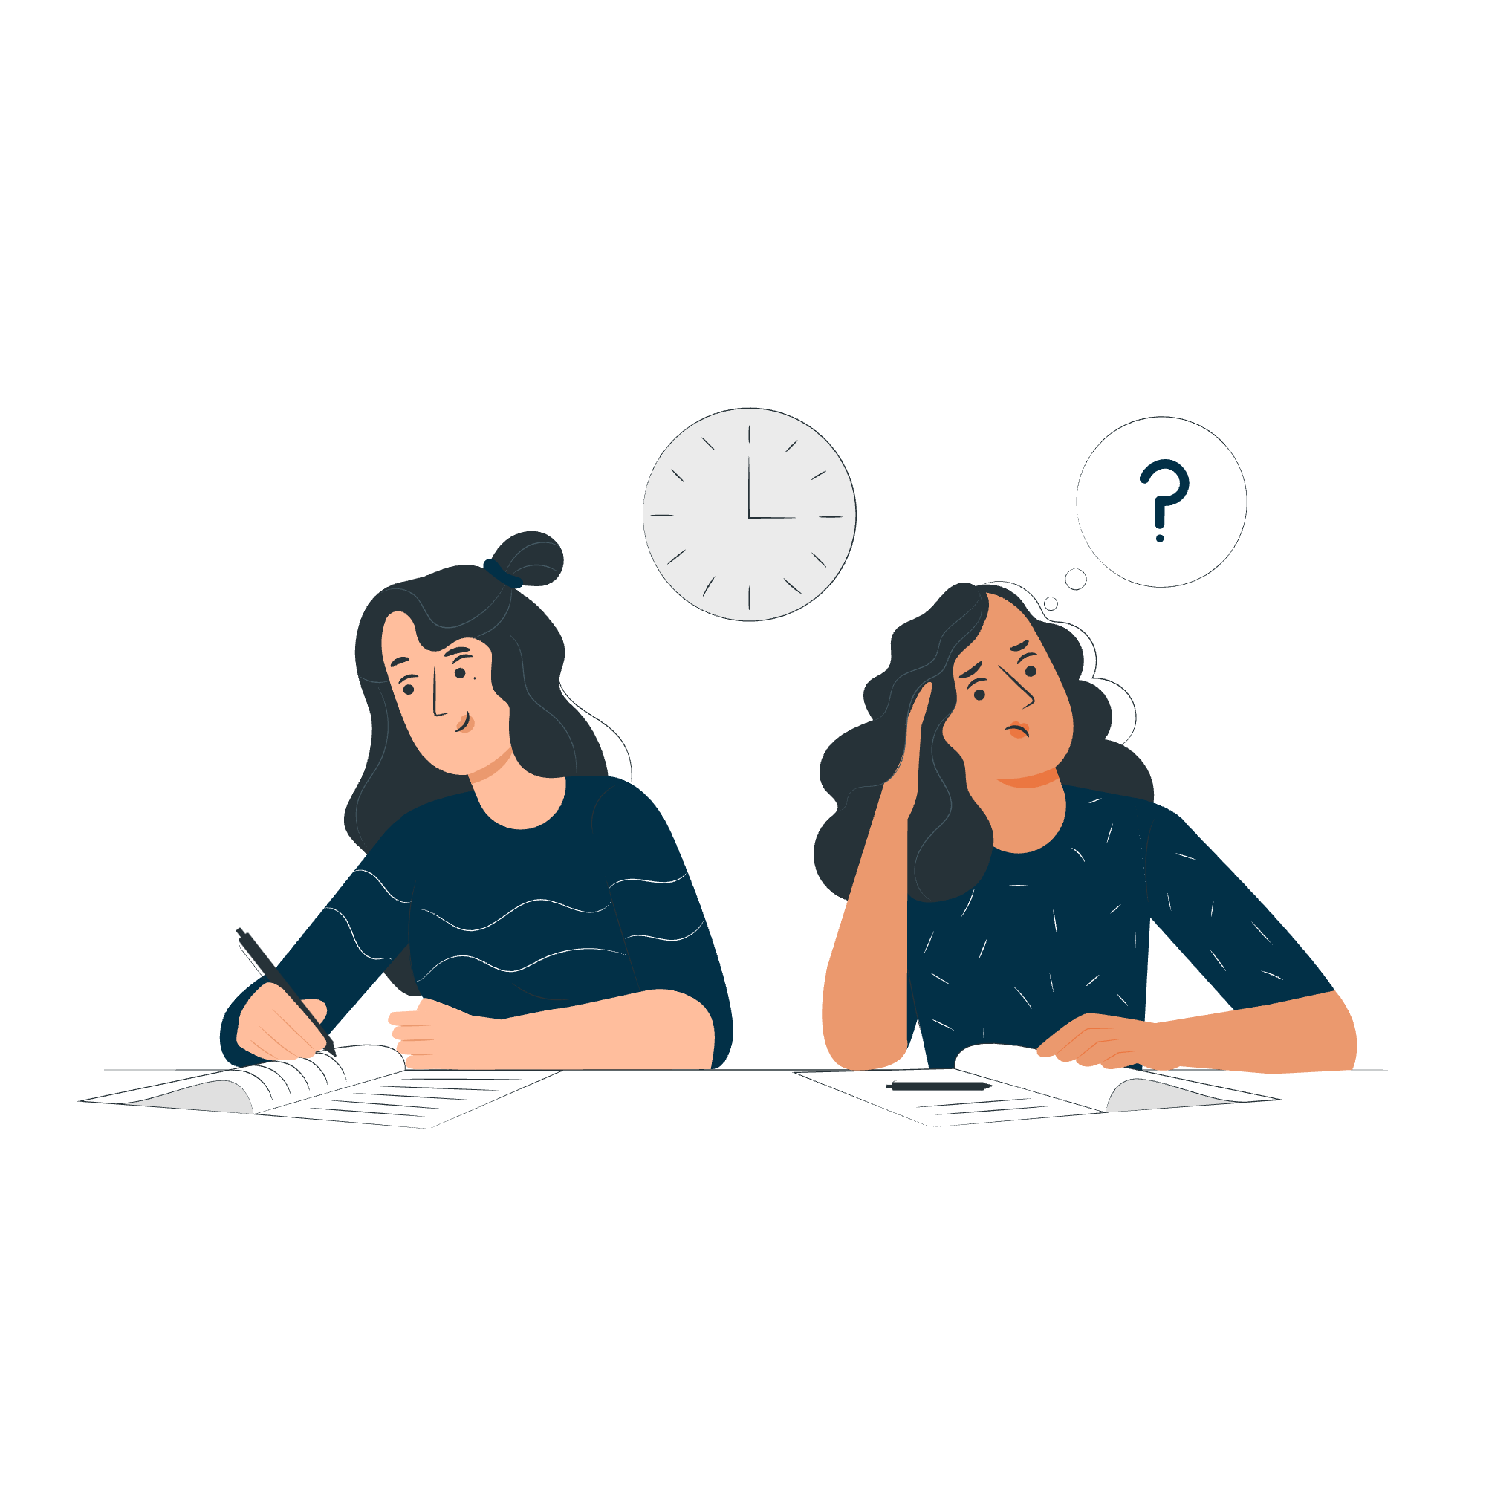
Democracy Mini Quiz!

Slide 22
True or False: I can find information on WhatsApp about voting in London.
True
False

Slide 23
True or False: I can find information on WhatsApp about voting in London.
True
False
In fact, there are two ways to get information on WhatsApp!
For personalised support on voting and translated guidance, you can use the GLA’s Whatsapp Chatbot. Just send a message to +44 7908 820136.
To get general updates and resources related to civic and democratic rights, follow the GLA and SOUK’s #NoVoteNoVoice Whatsapp Channel.

Slide 24
True or False: the email address of your MP is publicly available.
True
False

Slide 25
True or False: the email of your MP is publicly available.
True
False
Yes! You can find the email address of your MP, and any representative on WriteToThem.com

Slide 26
True or False: the debates in parliament are private.
True
False

Slide 27
True or False: the debates in parliament are private.
True
False
You can find transcripts and voting records from parliament on Hansard.

Slide 28
True or False: you need to apply to register to vote by post or by proxy if you wish to vote in this way.
True
False

Slide 29
True or False: you need to apply to register to vote by post or by proxy if you wish to vote in this way.
True
False
You need to register to vote first, at www.gov.uk/register-to-vote .
Once you have registered, you need to apply to register to vote by post or proxy on the following links:
gov.uk/apply-proxy-vote
gov.uk/apply-postal-vote

Slide 30
True or False: the only way to find out who your candidates are for upcoming elections is through leaflets delivered to your address.
True
False

Slide 31
True or False: the only way to find out who your candidates are is through leaflets delivered to your address.
True
False
You can find out which candidates are standing in your area at any time by checking WhoCanIVoteFor

Slide 32
True or False: if you don’t own an accepted form of photo ID you cannot vote in person.
True
False

Slide 33
True or False: if you don’t own an accepted form of photo ID you cannot vote in person.
True
False
Be prepared - if you don’t have an accepted form of photo ID, you can apply for a Voter Authority Certificate! These are free, valid for 10 years, and have no gender marker.
Apply here: gov.uk/apply-for-photo-id-voter-authority-certificate

Slide 34
True or False: your MP votes in parliament on specific issues and you can follow how they vote.
True
False

Slide 35
True or False: your MP votes in parliament on specific issues and you can follow how they vote.
True
False
You can find transcripts and voting records from parliament on Hansard.
Remember to use your voice to ensure your representatives reflect your views

Slide 36
Your voice matters, make sure it gets heard!
Check out the GLA Democracy Hub registertovote.london to:
Find more information on your civic and democratic rights
Find comprehensive answers to FAQs
Check the Democracy WhatsApp chatbot (+44 7908820136) and #NoVoteNoVoice WhatsApp channel
Find accessible resources, including in different languages

Slide 37
Thank You!
For more information contact the
GLA Democratic Participation Team at: democracy@london.gov.uk
Funded by the Greater London Authority, City Hall, Kamal Churchie Way, London, E16 1ZE

