Slide 1
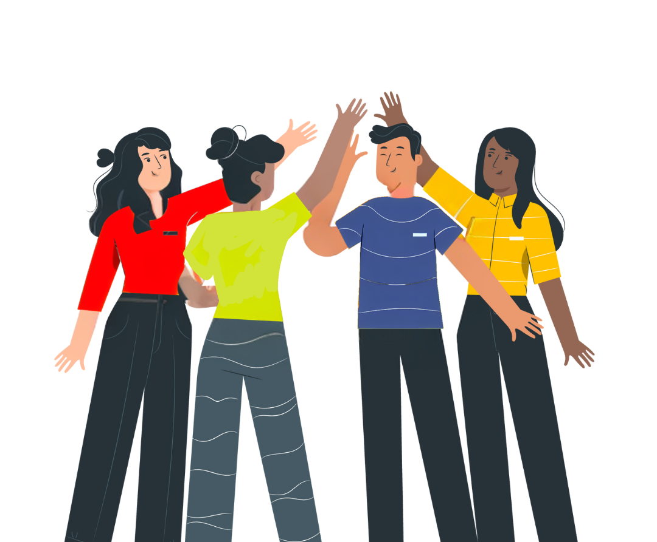
No Vote, No Voice!
Democracy doesn’t end at the ballot box, it starts there.
Funded by the Greater London Authority, City Hall, Kamal Churchie Way, London, E16 1ZE

Slide 2
In this session we will explore the following questions:
Why is it important to know your civic and democratic rights?
What is the difference between civic and democratic rights and how can you exercise those rights?
How can you have your voice heard in the voting system (if eligible)?
How can you continue to have your voice heard by your representatives beyond an election?

Slide 3
Why is it important to know your civic and democratic rights?

Slide 4
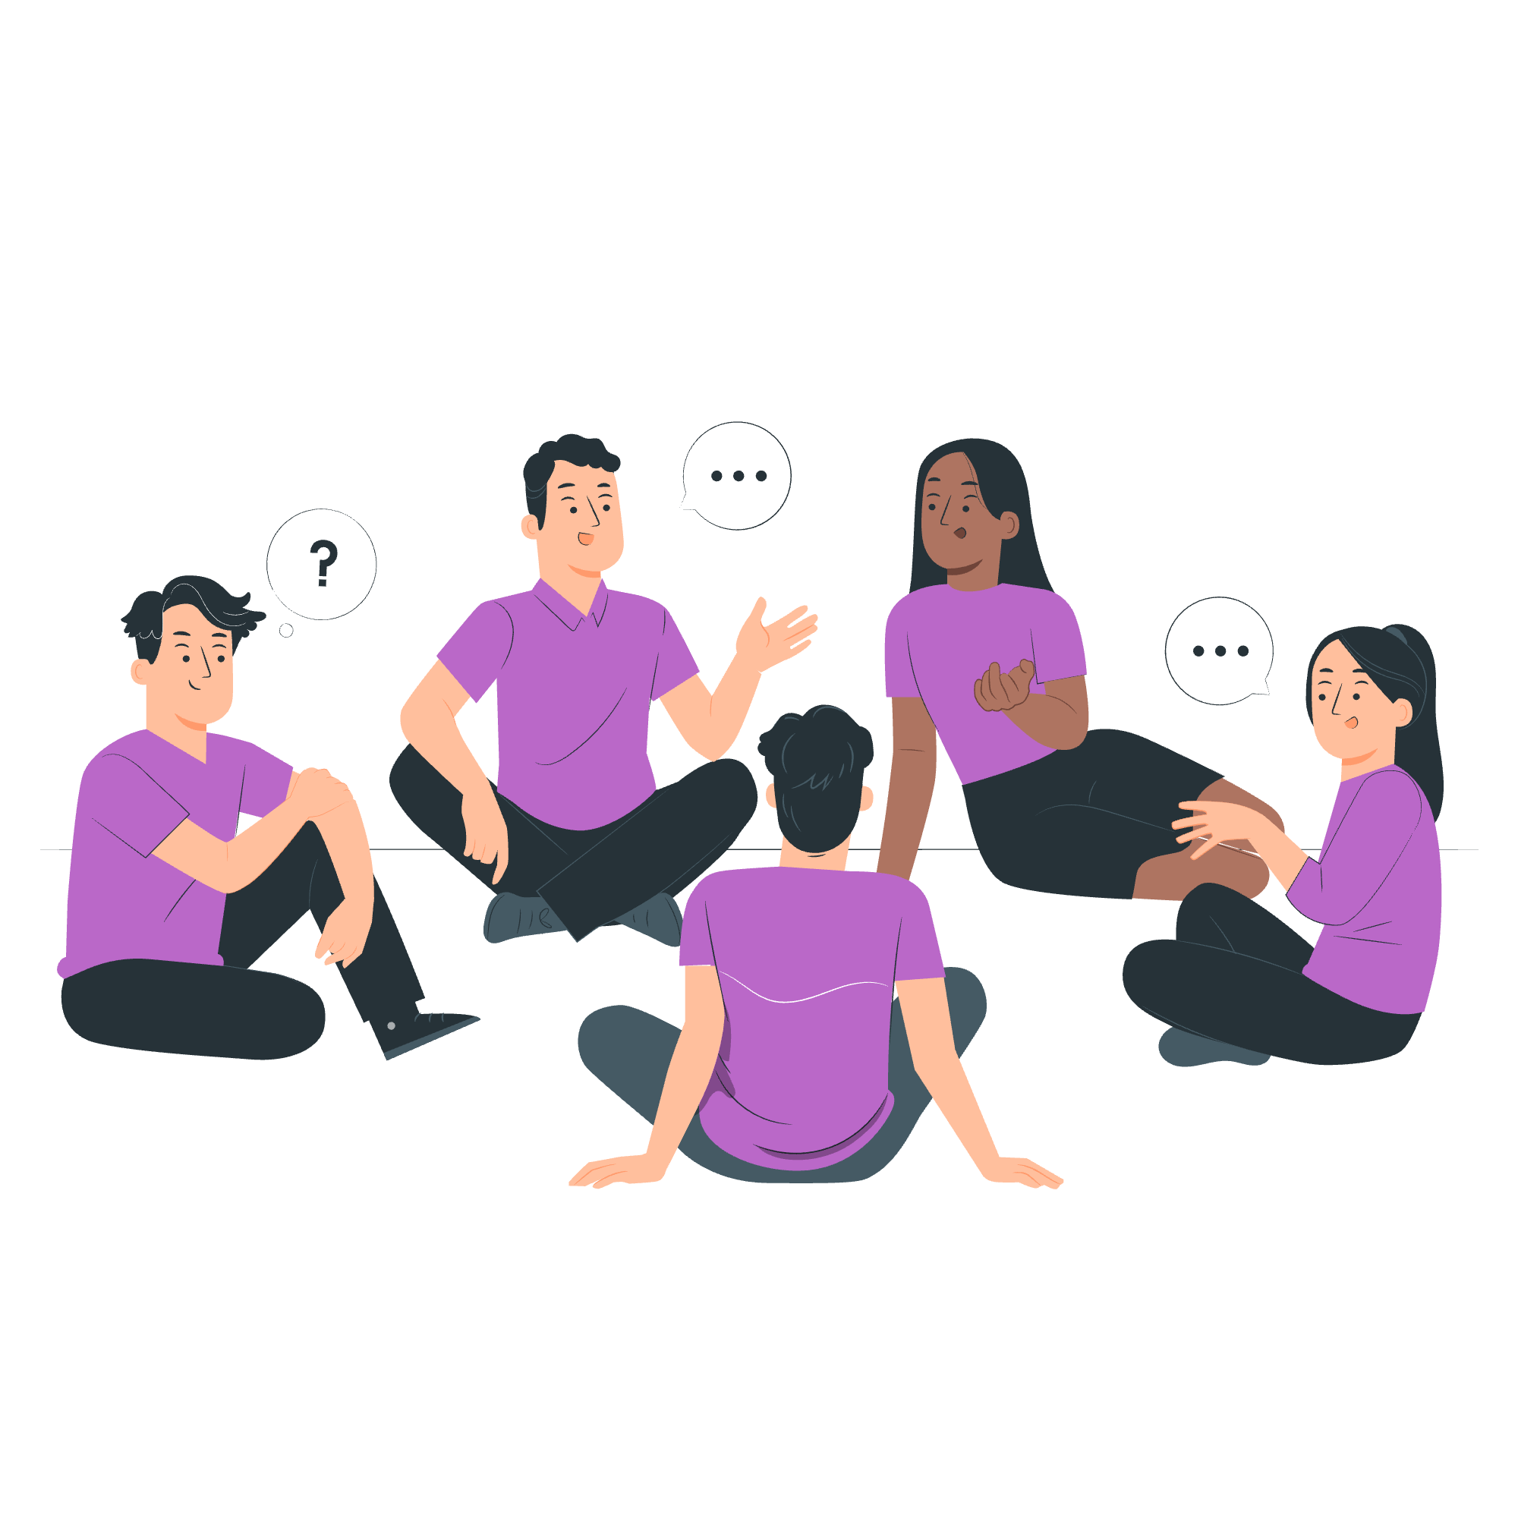
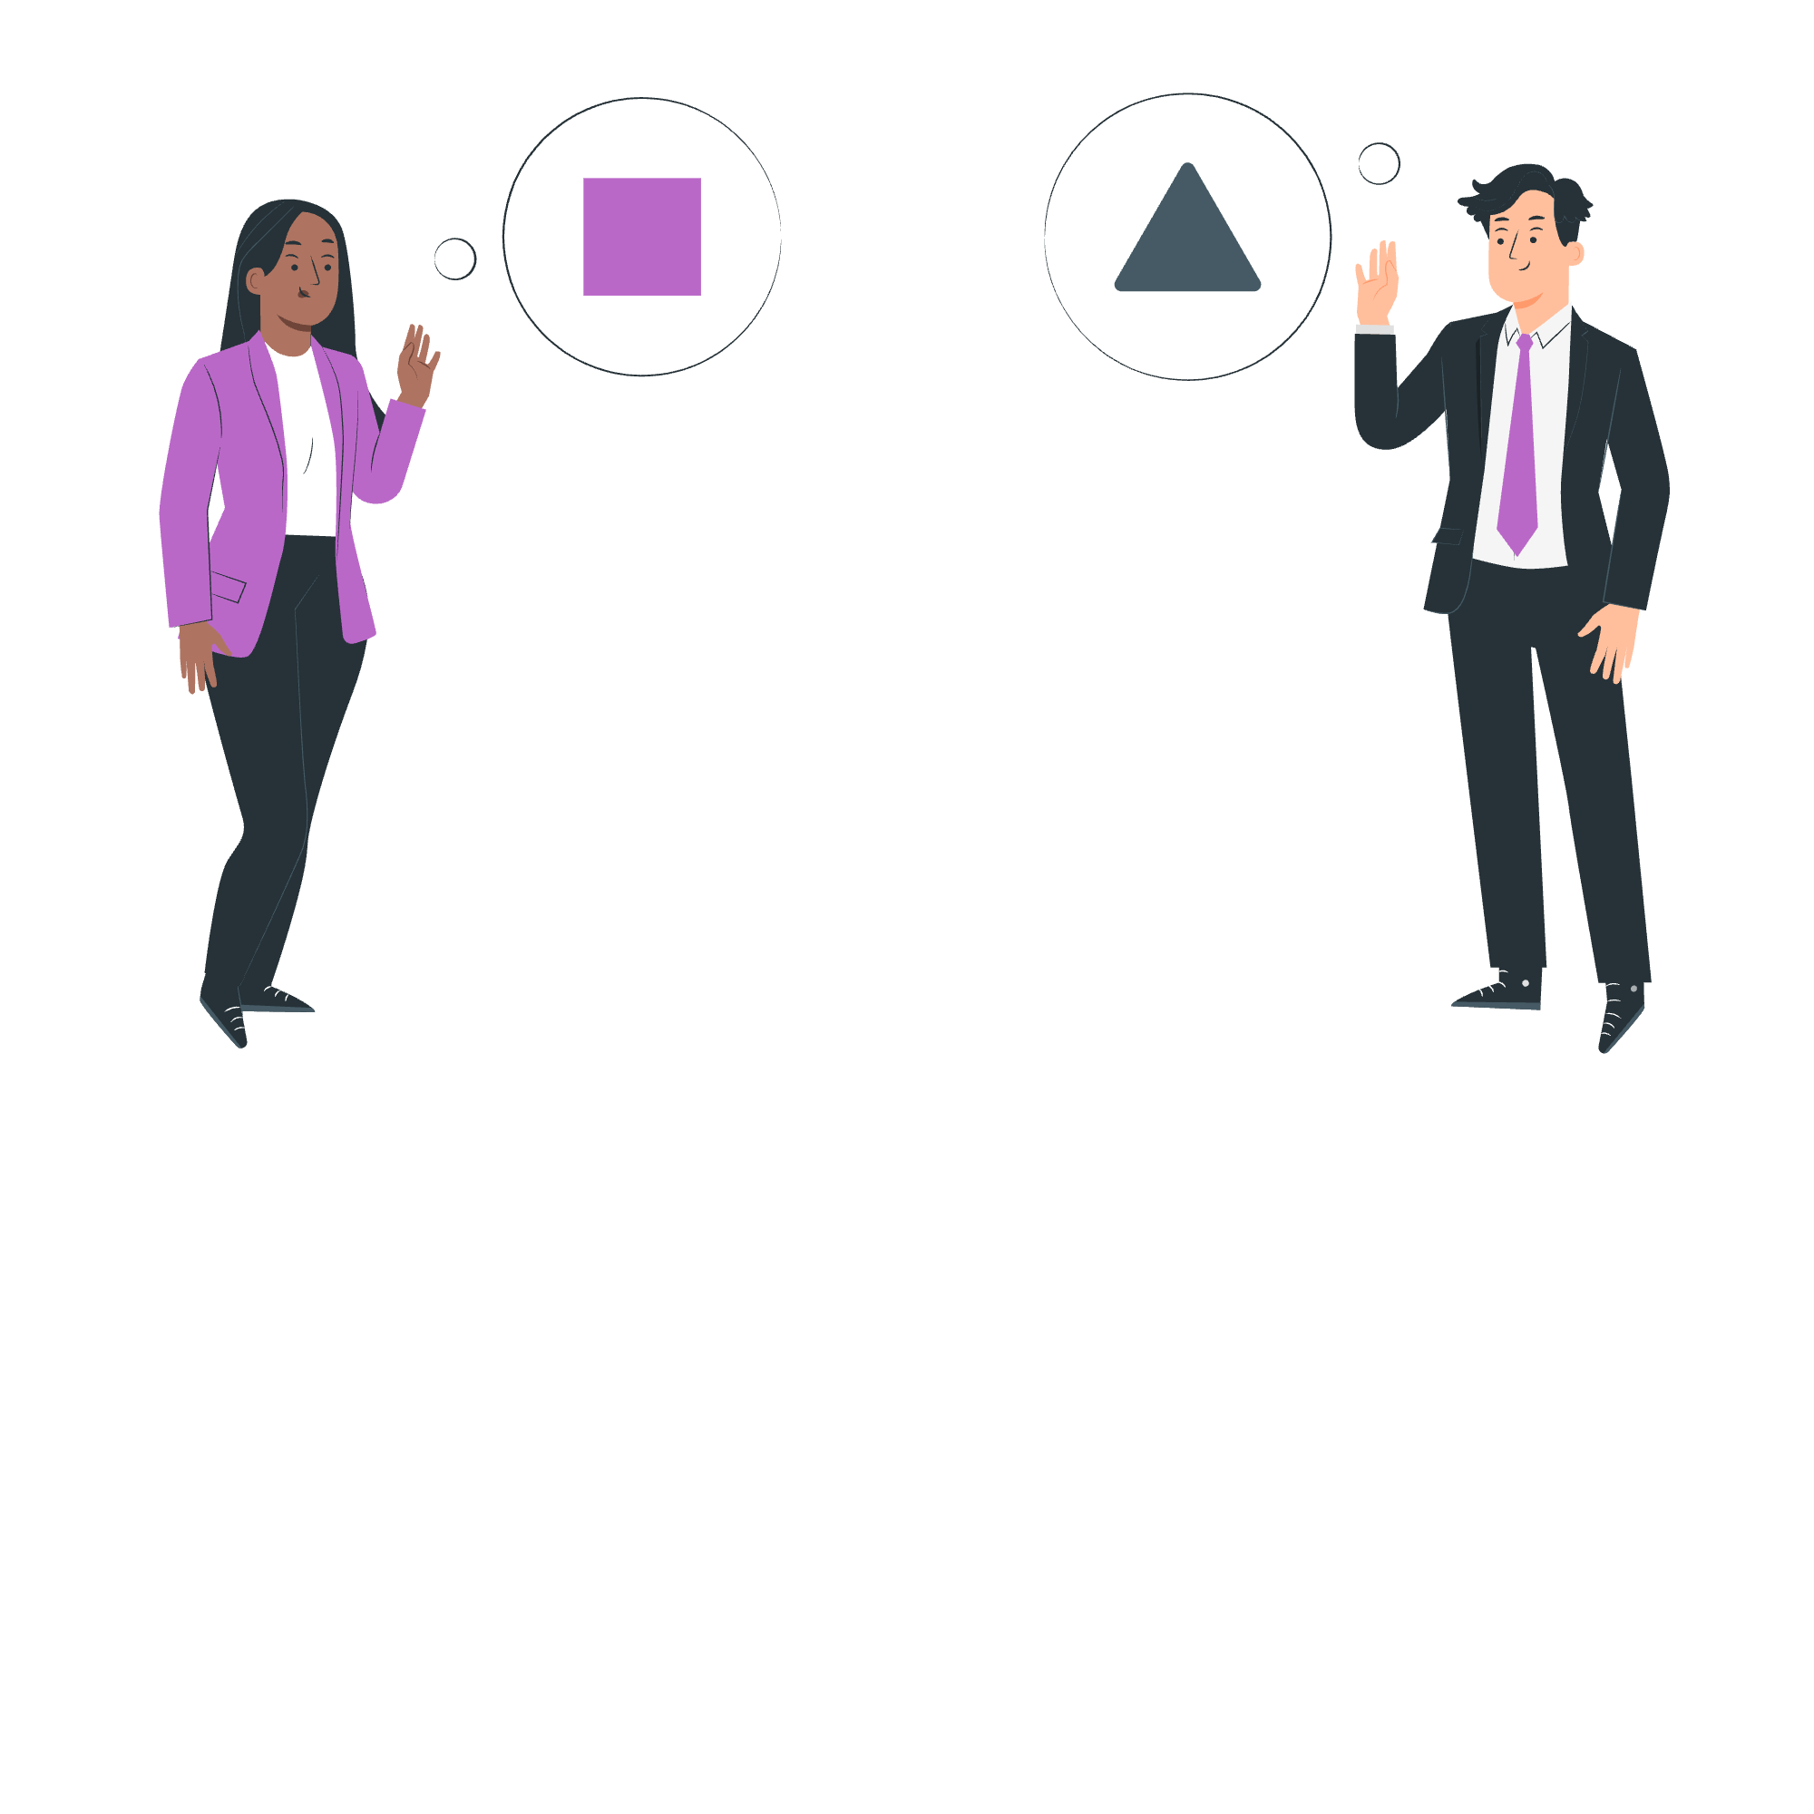
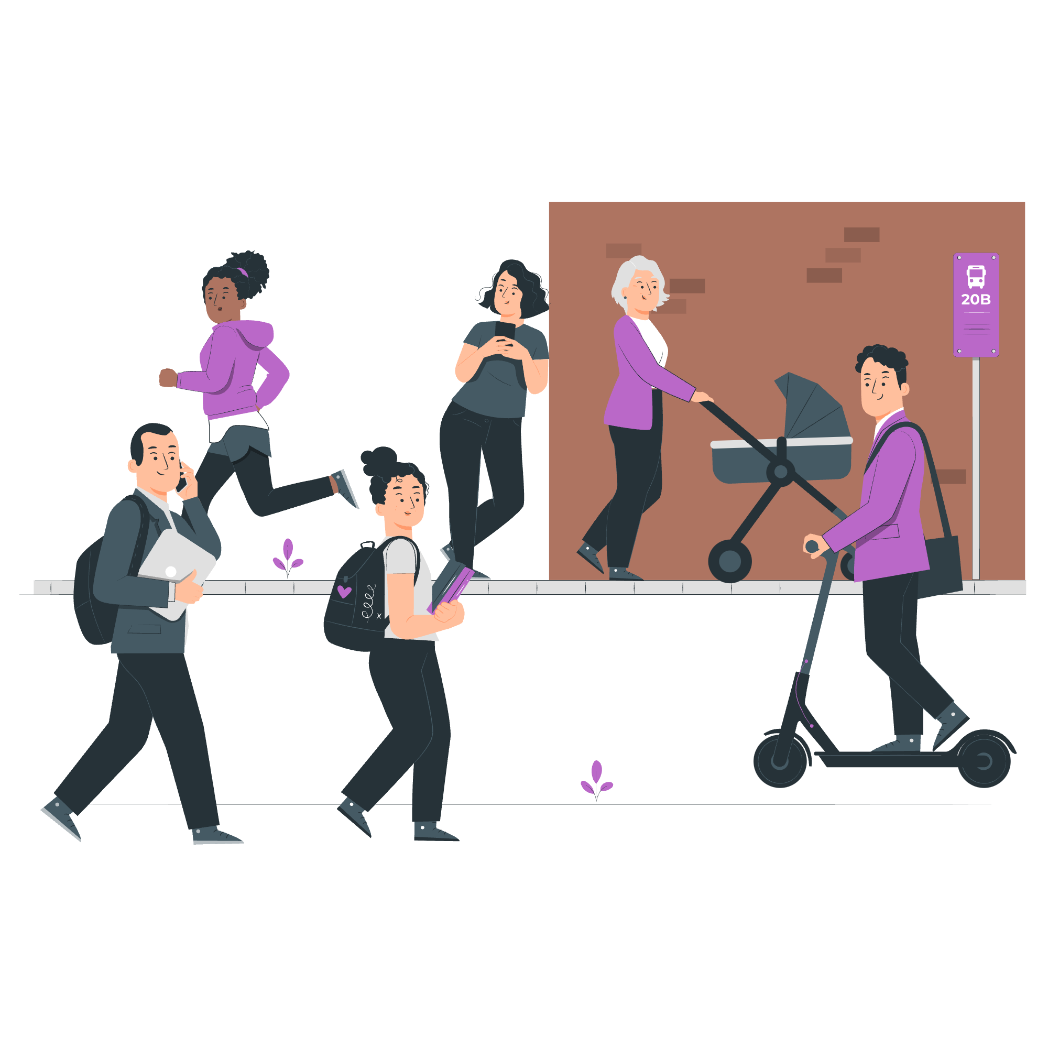
To have a voice
To build stronger communities
To engage with your representatives
Why participate in democracy and civic life?
To gain knowledge and skills
To support equality and justice
To make a difference on issues they care about

Slide 5
What is the difference between civic and democratic rights and
how can you exercise these rights?
Civic Rights include:
The ability to start or sign petitions
Taking part in peaceful, legal protest
Being involved in community organising
Volunteering
Democratic Rights include:
Registering to vote, if eligible
Voting in elections, such as local/ borough council, Mayor of London and London Assembly, general/ parliamentary elections
Taking part in citizens’ assemblies, or other forms of deliberative or participatory democracy
Standing for elected office

Slide 6
Civic rights:
Start or sign petitions
Official petitions appear on https://petition.parliament.uk/. If a petition reaches 10,000 signatures, the government will respond.
Take part in peaceful, legal protest
Everyone has the right to protest in a peaceful and legal way. If you’re planning a protest, you may need to notify the police in advance.
Community organising and volunteering
Community organising brings local people together to create the change they want to see. Volunteering helps you upskill, meet new people, and make a difference.

Slide 7
Democratic rights:
Register to vote and vote, if eligible
If you are eligible to vote, you can register at 16, and vote at 18. Your vote will help choose the candidate(s) that will represent you.
Stand for elected office
If eligible, at 18 you can also become a candidate for Mayor of London, London Assembly member, Member of Parliament (MP), local councillor.
Take part in Citizens’ Assemblies
A Citizens' Assembly is a randomly selected group of people who learn about and discuss specific issues, then make recommendations on related actions. You do not necessarily need to be eligible to vote to take part.

Slide 8
Who can you vote for?
There are three types of election in London:

Slide 9
Which London residents are eligible to vote in these elections?
 | Mayor of London and London Assembly | General / parliamentary | Local / borough
Must be at least 18 years of age | ✅ | ✅ | ✅
British or Irish citizens | ✅ | ✅ | ✅
Qualifying Commonwealth citizens | ✅ | ✅ | ✅
Qualifying EU citizens or EU citizens with retained rights | ✅ | ❌ | ✅
For further information on eligibility, head to electoralcommission.org.uk

Slide 10
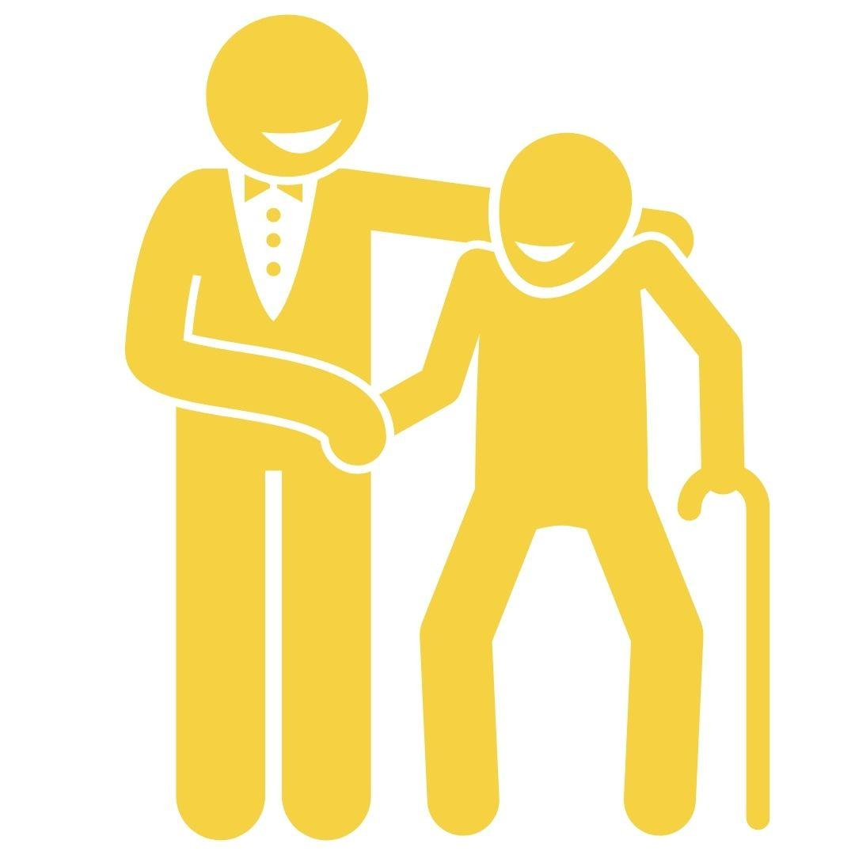
How can you have your voice heard in the voting system?
1
To register to vote, head to gov.uk/register-to-vote
2
You can vote in person, by post or by proxy
3
You need an accepted form of ID to vote in person
UK, Channel Islands or EEA driving licence
UK, commonwealth
or EEA passport
Blue Badge scheme card
These include, but are not limited to:
Notes:
Please note that a young person’s Oyster or student ID are NOT accepted forms of ID to vote in person.

Slide 11
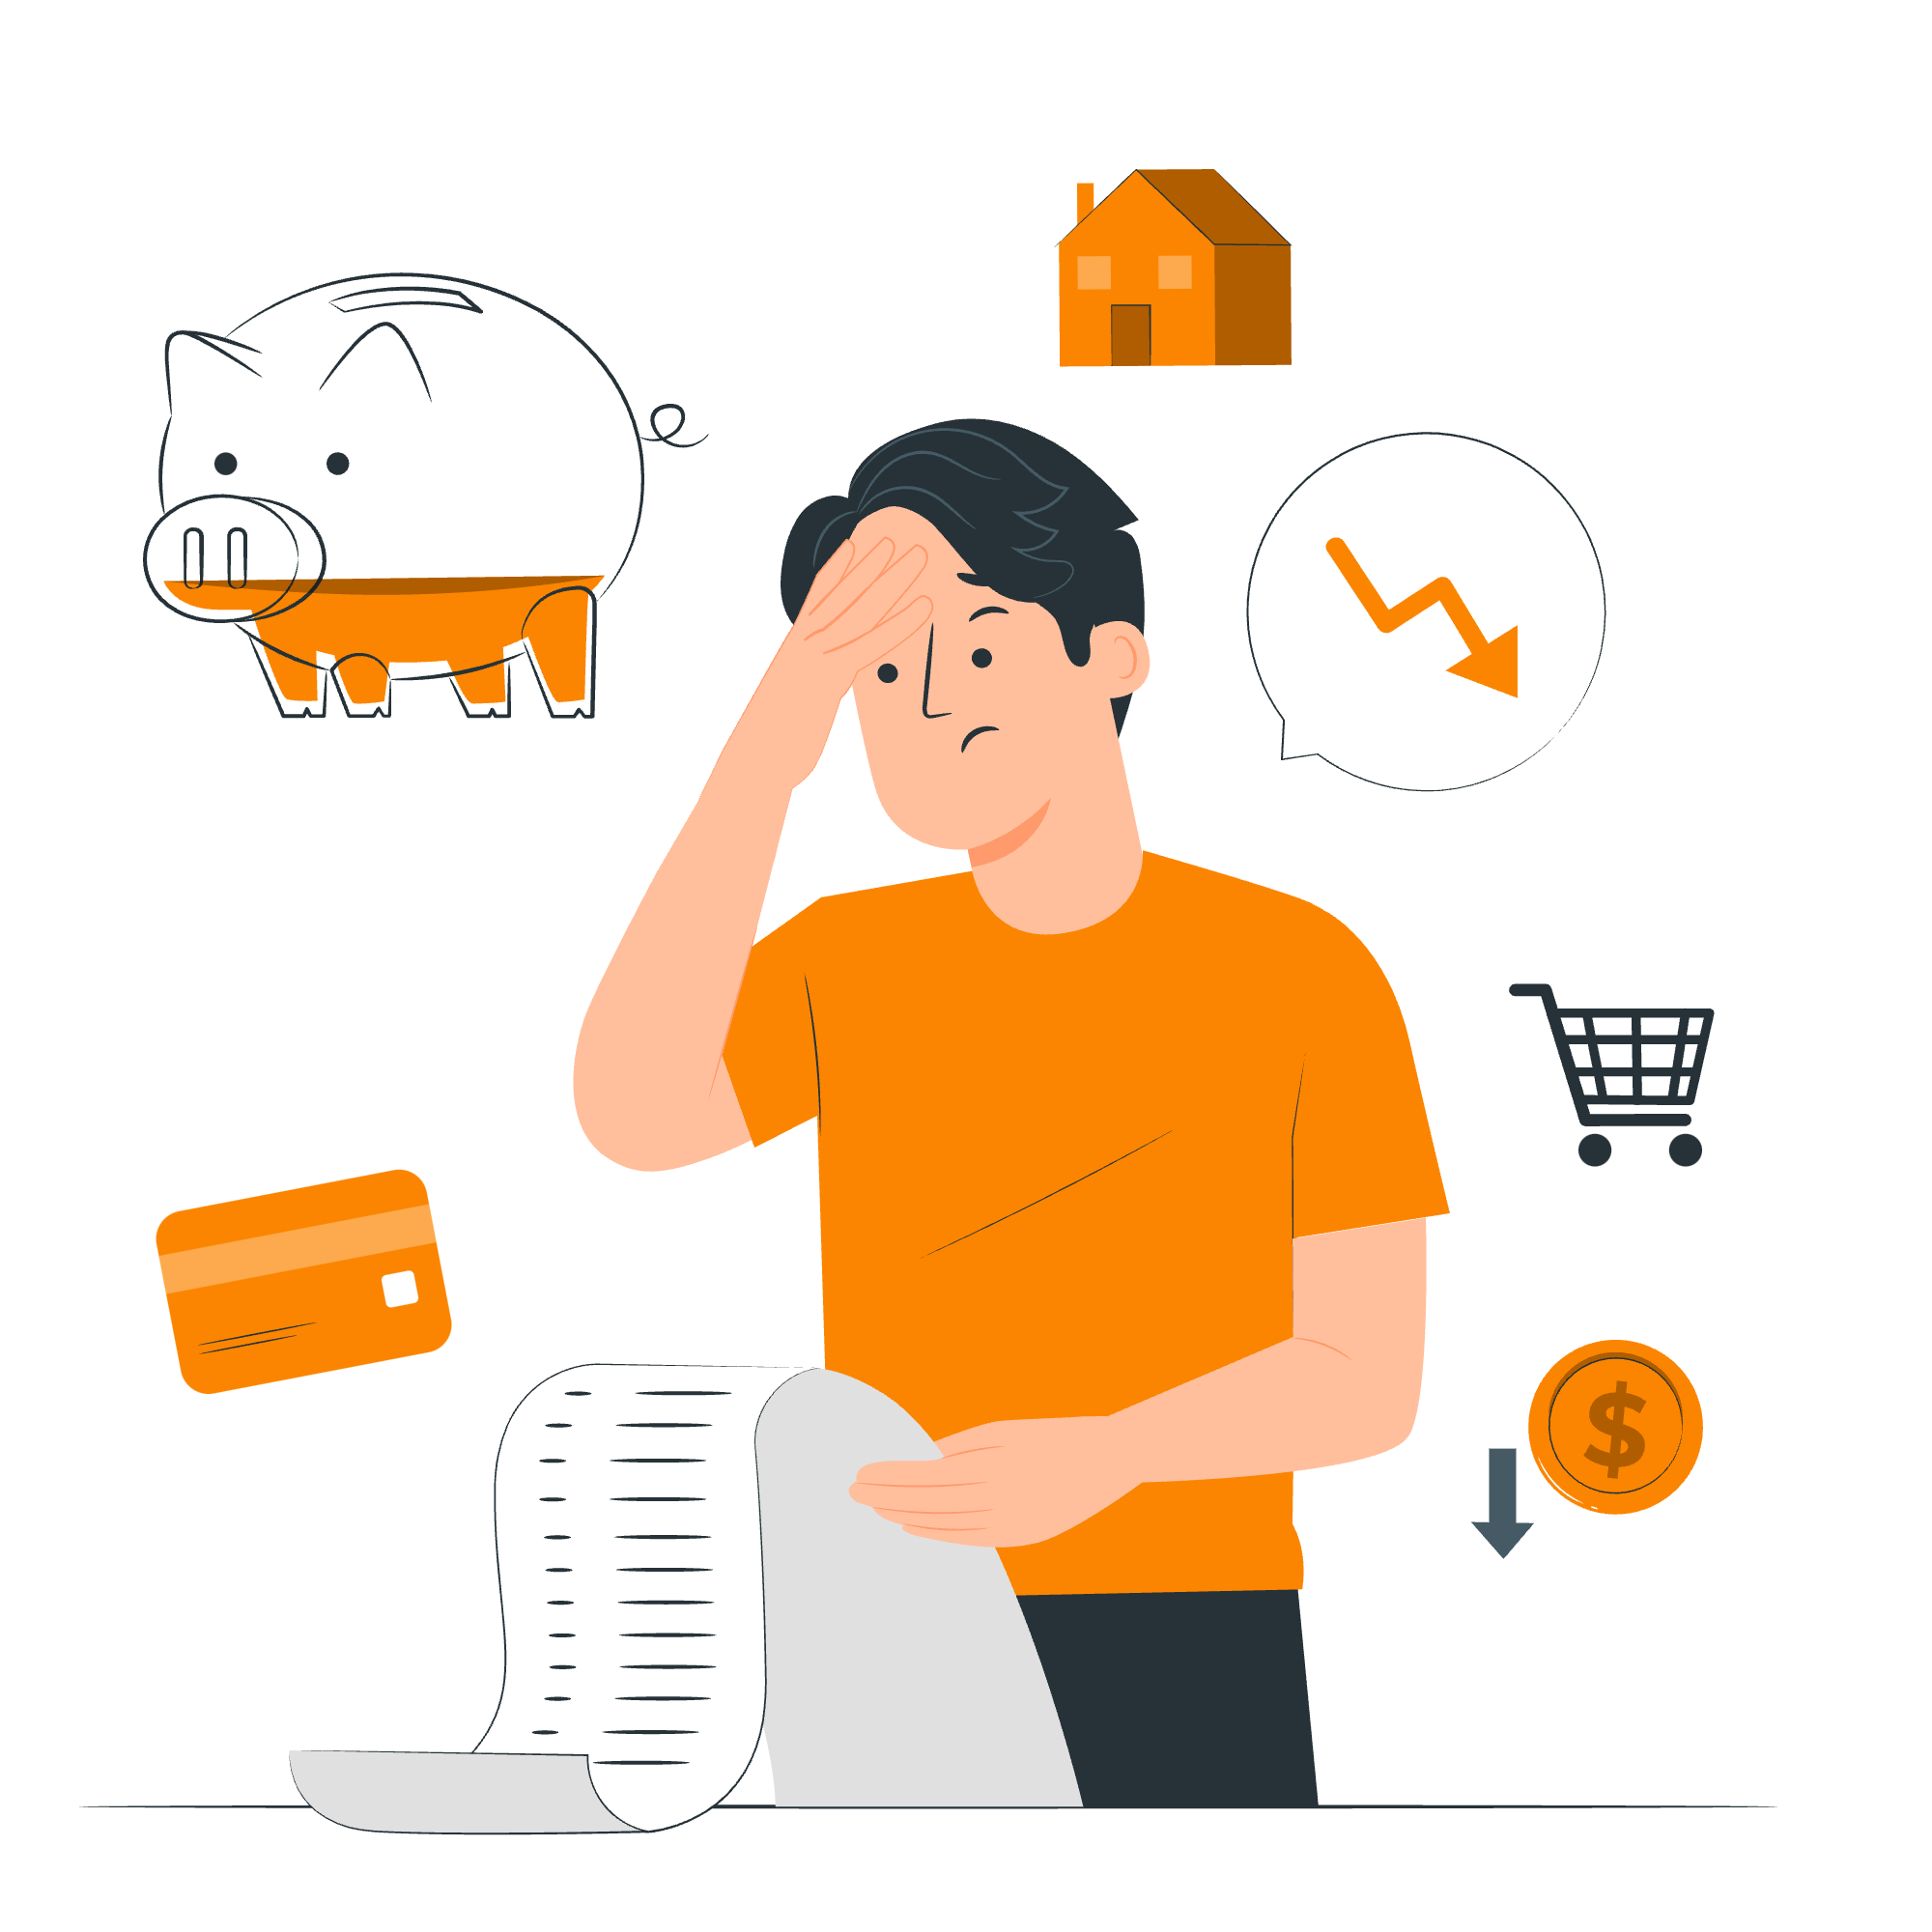
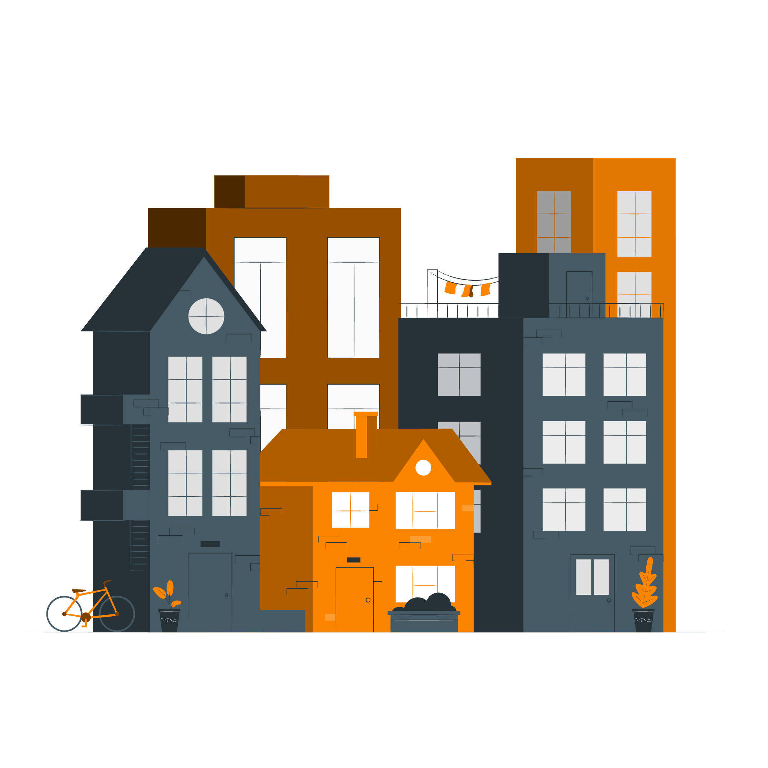
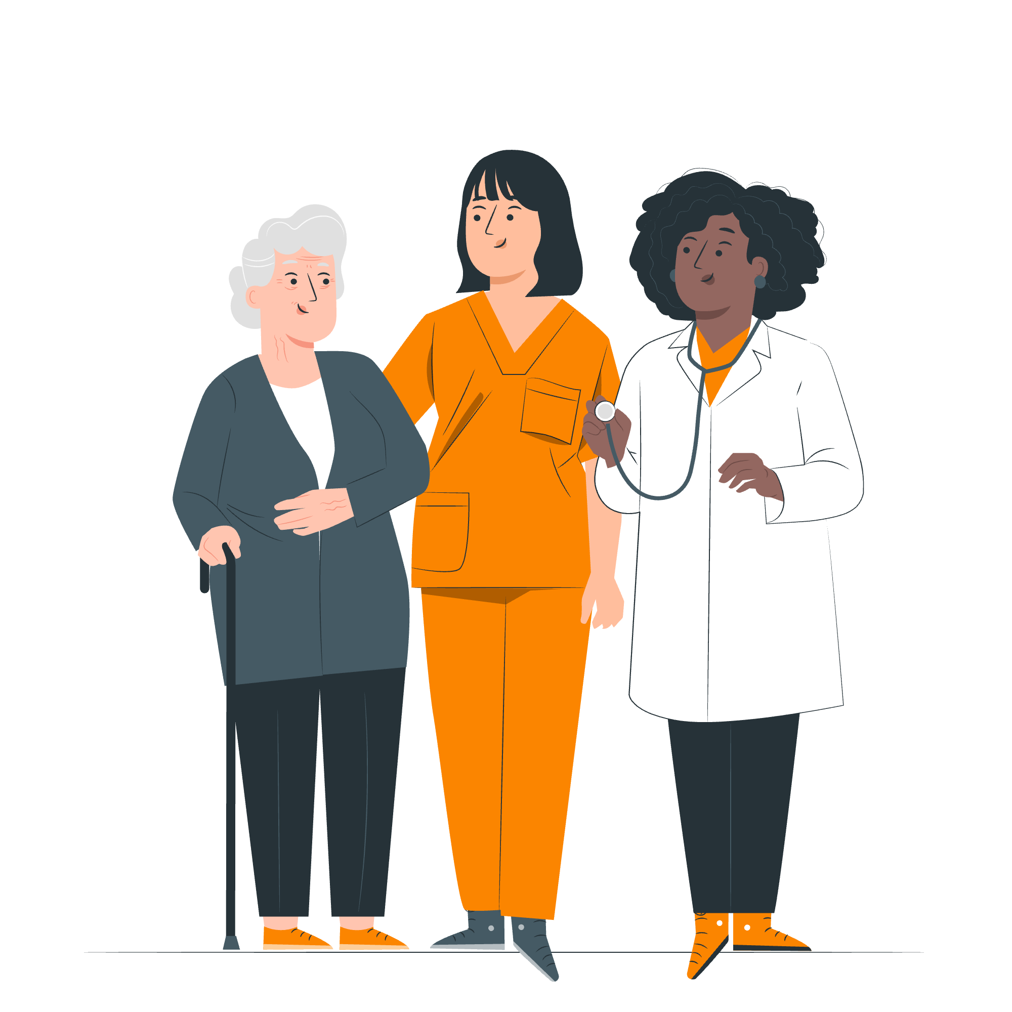
The environment
The economy
Education
What issues do you think are most important?
Healthcare
Transport
Housing

Slide 12
Why should you engage with the Greater London Authority?
Mayor of London
The Mayor of London is elected to set city-wide/ regional priorities:
• Transport for London
• Mayor’s Office for Policing and Crime
• London Fire Brigade
• Housing
• Environment
• Culture and arts
The Greater London Authority (GLA) is made up of
London Assembly
The London Assembly holds the Mayor to account.
• It is elected by Londoners, at the same time as the Mayor.
• It is composed of 25 Assembly Members: 14 represent geographic areas (2 or 3 London boroughs) and 11 work pan-London.

Slide 13
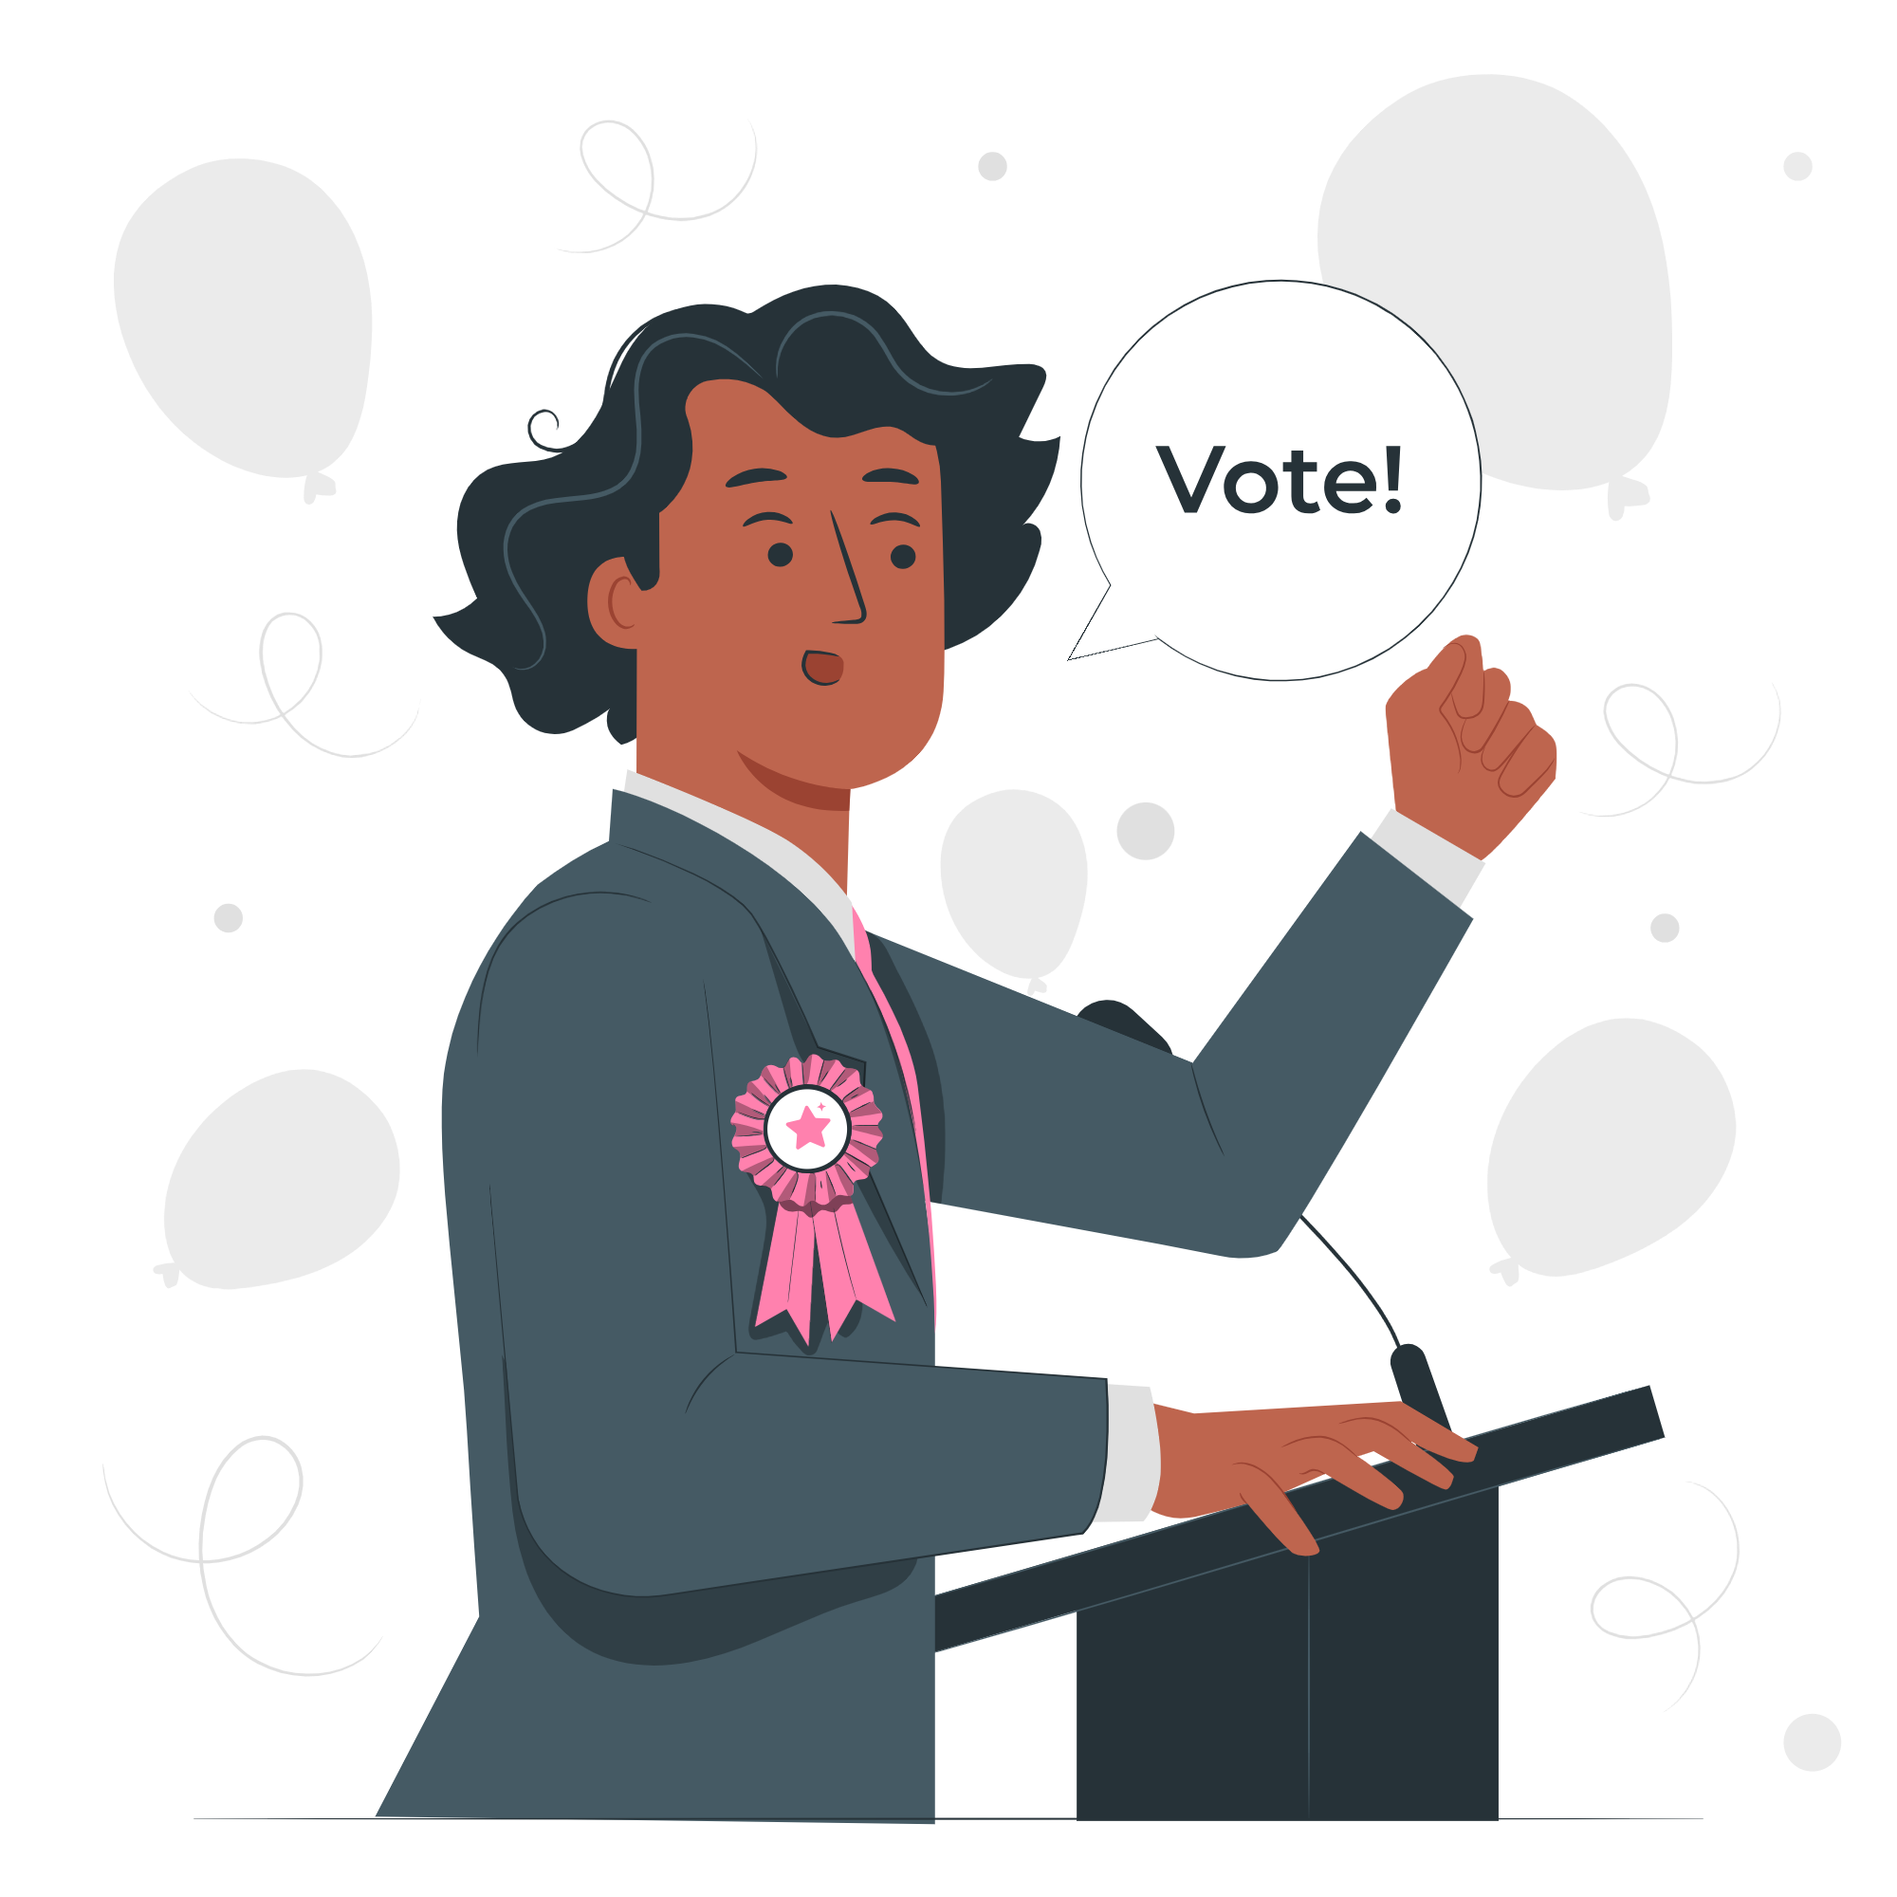
Why should you engage with your Member of Parliament (MP) or local councillor?
Member of Parliament (MP)
In a general election, you vote for the MP that you want to represent your constituency.
They can influence the decision-making in Parliament on:
The economy
Education
Health Care
Housing
Environment
Councillor
Work in the borough council (the local authority), which oversees this and more:
Council tax collections
Rubbish and recycling
Arts and leisure services
Housing (borough)
Environment (borough)
Health and wellbeing

Slide 14
1. Decide an issue you want to write to your representative about.
Dear [representative name],
I am writing to you today to express my [concern/ support] for [explain issue].
The reason I believe this is important is because [explain your reasoning].
I urge you to [ask them to take a specific action].
Thank you for your time and consideration on this important matter.
Yours sincerely,
[Your name]
2. Find your representatives’ contact details: www.writetothem.com
3. Write to them about the issue that matters to you! You can use the writing frame to guide you.
4. Send your letter/ email!

Slide 15
Start or sign petitions! Remember you can start a petition on an issue that matters to you.
petition.parliament.uk
london.gov.uk/london-assembly-petitions
Meet your MP! Most MPs will have days and times that they are available, known as ‘surgeries’.
Attend a hustings event! This is a meeting where candidates from different parties debate. This is normally before an election.
How else can you engage with your representatives?
Take part in citizens’ assemblies or other forms of deliberative and participatory democracy! You can make recommendations of a specific issue and potentially influence decisions.
Follow what your representatives are saying! You can find transcripts and voting records on hansard.parliament.uk
london.gov.uk/london-assembly-work
Take part in peaceful and legal protest! Show up for issues that matter to you.
Notes:
Important to note that whether you are eligible to vote or not, you can participate in these ways of engagement.

Slide 16
Your voice matters, make sure it gets heard!
Check out the GLA Democracy Hub registertovote.london to:
Find more information on your civic and democratic rights
Find comprehensive answers to FAQs
Check the Democracy WhatsApp chatbot and #NoVoteNoVoice WhatsApp channel
Find accessible resources, including in different languages

Slide 17
Thank You!
For more information contact the
GLA Democratic Participation Team at: democracy@london.gov.uk

